Slide 1
What is Statistics?
Fall 2019
ECON 291.01B
Probability and Statistics
Chapter 1
Notes:
The purpose of this course is to develop your knowledge of basic statistical techniques and methods and how to apply them to develop the business and personal intelligence that will help you make decisions.

Slide 2


Slide 3
Learning Objectives
Explain why knowledge of statistics is important
Define statistics and provide an example of how statistics is applied
Differentiate between descriptive and inferential statistics
Classify variables as qualitative or quantitative, and discrete or continuous
Distinguish between nominal, ordinal, interval, and ratio levels of measurement
List the ethical values associated with the practice of statistics

Slide 4
Why Study Statistics
Data are collected everywhere and require statistical knowledge to make the information useful.
Statistical techniques are used to make professional and personal decisions.
A knowledge of statistics is needed to understand the world and be conversant in your career.
In summary, statistics will help you make more effective personal and professional decisions.
Notes:
Study statistics and learn some basic techniques and applications that can be used everyday.

Slide 5
Weather Forecasting: Everybody watches weather forecasting. Computers models are built on statistical concepts. These computer models compare prior weather with the current weather and predict future weather.
Insurance: Companies use statistics (Acturian) to determine selection and rates.
Financials: In financial market also statistic has a role. Statistics are the key on how investors invest and make money.
Medicine: Statistics play a big role in the medical field. Before any drugs is prescribed, scientist must show a statistically valid rate of effectiveness and safety
Quality Testing: Statistical concepts are used in quality testing.
Predictions: Measurements are often used to make predictions. For example, they can help predict how tall a 4-year-old is likely to be in adulthood, which students are likely to do better in an academic program, or which candidates are most likely to succeed in a particular job.

Slide 6
What is Meant by Statistics
What is statistics?
It’s more than presenting numerical facts
Example: The inflation rate for the calendar year was 0.7%. By applying statistics we could compare this year’s inflation rate to past observations of inflation. Is it higher, lower, or about the same. Is there a trend of increasing or decreasing inflation?
STATISTICS The science of collecting, organizing, presenting, analyzing, and interpreting data to assist in making more effective decisions.
Notes:
Statistics is about collecting and processing information to create a conversation, to stimulate additional questions, and to provide a basis for making decisions. Chart 1-1 shows using statistics to analyze the distribution and market share of Frito-Lay products compared to the rest of the snack chip markets.

Slide 7
Types of Statistics
There are two types of statistics, descriptive and inferential
Descriptive statistics can be used to organize data into a meaningful form
You can summarize data and provide information that is easy to understand
Example: There are a total of 46,837 miles of interstate highways in the U.S. The interstate system represents 1% of the nations roads but carries more than 20% of the traffic. Texas has the most interstate highways and Alaska doesn’t have any.
DESCRIPTIVE STATISTICS Methods of organizing, summarizing, and presenting data in an informative way.
Notes:
The type of statistics depends on the questions asked and the type of data available. Unorganized data is of little value as is, but descriptive statistics can be used to summarize the data and provide information that is easy to understand. Statistical methods and techniques to generate descriptive statistics are presented in chapters 2 and 4. Chapter 3 discusses statistical measures to summarize the characteristics of a distribution.

Slide 8
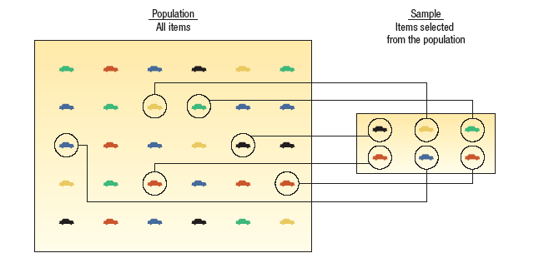
Types of Statistics
POPULATION The entire set of individuals or objects of interest or the measurements obtained from all individuals or objects of interest.
SAMPLE A portion or part of the population of interest.
Notes:
You can save time and money by collecting a sample to estimate the population parameter.

Slide 9
Types of Statistics
Inferential statistics can be used to estimate properties of a population
You can make decisions based on a limited set of data
Example: TV networks constantly monitor the popularity of their programs by hiring Nielsen to sample the preferences of TV viewers. For example, 9% of a sample of households with television watched The Big Bang Theory during the week of November 2, 2015.
INFERENTIAL STATISTICS The methods used to estimate a property of a population on the basis of a sample.
Notes:
When it is not practical to study an entire population, use surveys and sampling to estimate the characteristic under consideration. Inferential statistics is used widely in business, agriculture, politics, and government.

Slide 10
Types of Variables
There are two basic types of variables
QUALITATIVE VARIABLE An object or individual is observed and recorded as a non-numeric characteristic or attribute.
Examples: gender, state of birth, eye color
QUANTITATIVE VARIABLE A variable that is reported numerically.
Examples: balance in your checking account, the life of a car battery, the number of people employed by a company
Notes:
There are two basic types of variables, qualitative (non-numeric) and quantitative (numeric). When working with qualitative variables, we simply count the number of observations for each category. Then the percent for each category can be determined. Qualitative variables are often summarized in charts and bar graphs.

Slide 11
Types of Variables
Quantitative variables can be discrete or continuous
Discrete variables are typically the result of counting
  Values have “gaps” between the values
  Examples: the number of bedrooms in a house, the number of students in a statistics course
Continuous variables are usually the result of measuring something
  Can assume any value within a specific range
  Examples: the air pressure in a tire, duration of flights from Orlando to San Diego
Notes:
There are two types of quantitative variables and they are usually reported numerically.

Slide 12
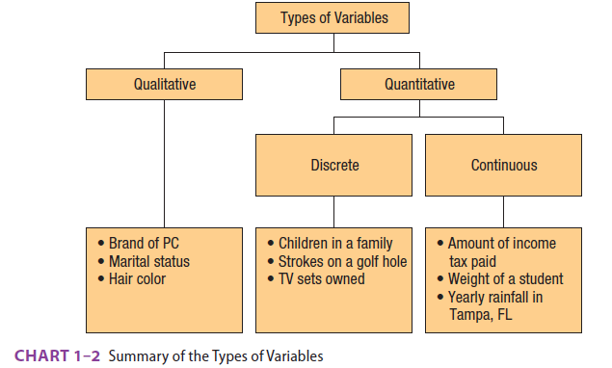
Types of Variables Summary
Notes:
Chart 1-2 summarizes the two basic types of variables.

Slide 13
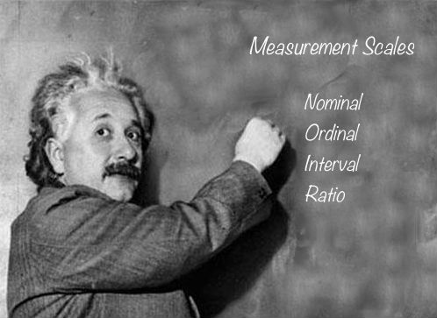

Slide 14
Types of Data & Measurement Scales: Nominal, Ordinal, Interval and Ratio
In statistics, there are four data measurement scales:
  Nominal
  ordinal
  interval
  ratio.

Slide 15
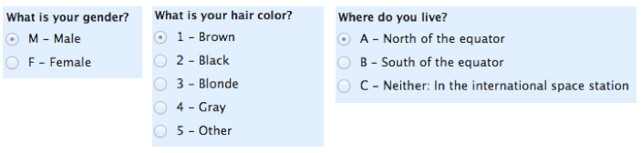
Nominal
Let’s start with the easiest one to understand. Nominal scales are used for labeling variables, without any quantitative value.
“Nominal” scales could simply be called “labels.”
Here are some examples, below. Notice that all of these scales are mutually exclusive (no overlap) and none of them have any numerical significance.
A good way to remember all of this is that “nominal” sounds a lot like “name” and nominal scales are kind of like “names” or labels.

Slide 16
Ordinal
With ordinal scales, the order of the values is what’s important and significant, but the differences between each one is not really known.
Take a look at the example below. In each case, we know that a #4 is better than a #3 or #2, but we don’t know–and cannot quantify–how much better it is.
For example, is the difference between “OK” and “Unhappy” the same as the difference between “Very Happy” and “Happy?” We can’t say.
Ordinal scales are typically measures of non-numeric concepts like satisfaction, happiness, discomfort, etc.
“Ordinal” is easy to remember because is sounds like “order” and that’s the key to remember with “ordinal scales”–it is the order that matters, but that’s all you really get from these.
The best way to determine central tendency on a set of ordinal data is to use the mode or median; a purist will tell you that the mean cannot be defined from an ordinal set.

Slide 17


Slide 18
Interval
Interval scales are numeric scales in which we know both the order and the exact differences between the values.
The classic example of an interval scale is Celsius temperature because the difference between each value is the same. For example, the difference between 60 and 50 degrees is a measurable 10 degrees, as is the difference between 80 and 70 degrees.
Interval scales are nice because the realm of statistical analysis on these data sets opens up.
For example, central tendency can be measured by mode, median, or mean; standard deviation can also be calculated.
Like the others, you can remember the key points of an “interval scale” pretty easily. “Interval” itself means “space in between,” which is the important thing to remember–interval scales not only tell us about order, but also about the value between each item.
Here’s the problem with interval scales: they don’t have a “true zero.” For example, there is no such thing as “no temperature,” at least not with celsius. In the case of interval scales, zero doesn’t mean the absence of value, but is actually another number used on the scale, like 0 degrees celsius. Negative numbers also have meaning. Without a true zero, it is impossible to compute ratios. With interval data, we can add and subtract, but cannot multiply or divide.

Slide 19
Ratio
Ratio scales are the ultimate nirvana when it comes to data measurement scales because they tell us about the order, they tell us the exact value between units, AND they also have an absolute zero–which allows for a wide range of both descriptive and inferential statistics to be applied.
Everything above about interval data applies to ratio scales, plus ratio scales have a clear definition of zero. Good examples of ratio variables include height, weight, and duration.
Ratio scales provide a wealth of possibilities when it comes to statistical analysis. These variables can be meaningfully added, subtracted, multiplied, divided (ratios). Central tendency can be measured by mode, median, or mean; measures of dispersion, such as standard deviation and coefficient of variation can also be calculated from ratio scales.

Slide 20
Summary
In summary, nominal variables are used to “name,” or label a series of values.
Ordinal scales provide good information about the order of choices, such as in a customer satisfaction survey.
Interval scales give us the order of values + the ability to quantify the difference between each one.
Finally, Ratio scales give us the ultimate–order, interval values, plus the ability to calculate ratios since a “true zero” can be defined.

Slide 21
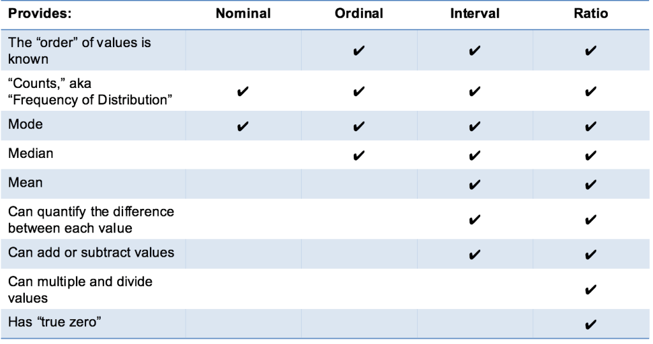

Slide 22
Another way to explain
Levels of Measurement
There are four levels of measurement
  Nominal, ordinal, interval, and ratio
The level of measurement determines the type of statistical analysis that can be performed
Nominal is the lowest level of measurement
Examples: classifying M&M candies by color, identifying students at a football game by gender
NOMINAL LEVEL OF MEASUREMENT Data recorded at the nominal level of measurement is represented as labels or names. They have no order. They can only be classified and counted.
Notes:
Data can be classified according to levels of measurement and the level of measurement will determine how the data should be summarized and presented. The nominal level of measurement does not permit any mathematical operation that has any valid interpretation even if numbers are assigned to the labels or names.

Slide 23
Levels of Measurement
The next level of measurement is the ordinal level
The rankings are known but not the magnitude of differences between groups
Examples: the list of top ten states for best business climate, student ratings of professors
ORDINAL LEVEL OF MEASUREMENT Data recorded at the ordinal level of measurement is based on a relative ranking or rating of items based on a defined attribute or qualitative variable. Variables based on this level of measurement are only ranked and counted.
Notes:
A qualitative variable or attribute is either ranked or rated on a relative scale such as rating a professor as superior, good, average, poor, and inferior. Notice, there is no way to determine the magnitude of the difference between superior and good or any other ranking.

Slide 24
Levels of Measurement
The next level of measurement is the interval level
This data has all the characteristics of ordinal level data plus the differences between the values are meaningful
There is no natural 0 point
Examples: the Fahrenheit temperature scale, dress sizes
INTERVAL LEVEL OF MEASUREMENT For data recorded at the interval level of measurement, the interval or the distance between values is meaningful. The interval level of measurement is based on a scale with a known unit of measurement.
Notes:
An example of interval level measurement is temperature; temperatures can be ranked and the differences between the values is meaningful. Additionally, a zero does not represent the absence of the condition; in this example of temperature, a zero just means it is really cold.

Slide 25
Levels of Measurement
The highest level of measurement is the ratio level
The data has all the characteristics of the interval scale and ratios between numbers are meaningful
The 0 point represents the absence of the characteristic
Examples: wages, changes in stock prices, and weight
RATIO LEVEL OF MEASUREMENT Data recorded at the ratio level of measurement are based on a scale with a known unit of measurement and a meaningful interpretation of zero on the scale.
Notes:
Almost all quantitative variables are ratio level; the zero point and ratios between two numbers is meaningful at this level. Money is an example of ratio level measurement. If you have no money, you have zero dollars and a wage of $50 per hour is twice as much as a wage of $25 per hour.

Slide 26
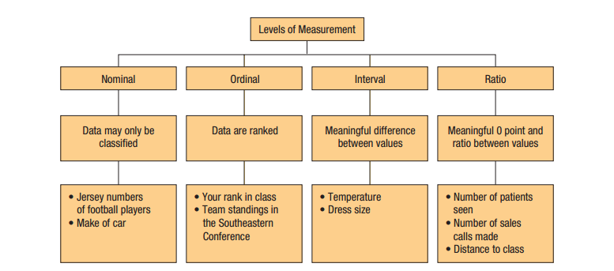
Levels of Measurement Summary
Notes:
Chart 1-3 summarizes the 4 levels of measurement. Statistical methods to analyze nominal level data are covered in chapter 15 and methods used for ordinal-level data are discussed in chapter 16. Methods of analyzing interval or ratio level data are presented in chapters 9-14.

Slide 27
Ethics and Statistics
Practice statistics with integrity and honesty when collecting, organizing, summarizing, analyzing, and interpreting numerical information
Maintain an independent and principled point of view when analyzing and reporting finding and results
Question reports that are based on data that
  do not fairly represent the population
  does not include all relevant statistics
  introduces bias in an attempt to mislead or misrepresent

Slide 28
Summary:
Statistics is the science of collecting, organizing, presenting, analyzing, and interpreting data to assist in making more effective decisions.
There are two types of statistics.
  Descriptive statistics are procedures used to organize and summarize data.
  Inferential statistics involve taking a sample from a population and making estimates about a population based on the sample results.
    A population is an entire set of individuals or objects of interest or the measurements obtained from all individuals or objects of interest.
    A sample is a part of the population.

Slide 29
Summary (Continued)
There are two types of variables.
  A qualitative variable is nonnumeric.
    Usually we are interested in the number or percent of the observations in each category.
    Qualitative data are usually summarized in graphs and bar charts.
  There are two types of quantitative variables and they are usually reported numerically.
    Discrete variables can assume only certain values, and there are usually gaps between values.
    A continuous variable can assume any value within a specified range.

Slide 30
Summary (Continued)
4. There are four levels of measurement.
  With the nominal level, the data are sorted into categories with no particular order to the categories.
  The ordinal level of measurement presumes that one classification is ranked higher than another.
  The interval level of measurement has the ranking characteristic of the ordinal level of measurement plus the characteristic that the distance between values is a constant size.
  The ratio level of measurement has all the characteristics of the interval level, plus there is a 0 point and the ratio of two values is meaningful.

Slide 31
Describing Data: Frequency Tables, Frequency Distributions, and Graphic Presentation
Chapter 2
Notes:
This chapter uses data from the Applewood Auto Group to demonstrate how to create frequency tables and frequency distributions. Then the grouped data is presented graphically.

Slide 32
Learning Objectives
Summarize qualitative variables with
  Frequency tables
  Relative frequency tables
Display a frequency table using a bar chart
Summarize quantitative variables with
  Frequency distributions
  Relative frequency distributions
Display a frequency distribution using a histogram and frequency polygon

Slide 33
Business scenario: Tracking and analyzing Sales and profits at Applewood Auto Group
The Applewood Auto Group operates four dealerships:
Tionesta Ford Lincoln sells Ford and Lincoln cars and trucks.
Olean Automotive Inc. has the Nissan and GM trucks.
Sheffield Motors Inc. sells Buick, GMC trucks, Hyundai, and Kia.
Kane Motors offers the Chrysler, Dodge, Jeep, BMW and Volvo.
Every month, Ms. Ball, sales manager collects data from each of the four dealerships and enters them into an Excel spreadsheet.
Last month the Applewood Auto Group sold 180 vehicles at the four dealerships.

Slide 34
Business scenario: Tracking and analyzing Sales and profits at Applewood Auto Group
The variables collected include:
Age—the age of the buyer at the time of the purchase.
Profit—the amount earned by the dealership on the sale of each vehicle.
Location—the dealership where the vehicle was purchased.
Vehicle type—SUV, sedan, compact, hybrid, or truck.
Previous—the number of vehicles previously purchased by the consumer at the dealership.

Slide 35


Slide 36
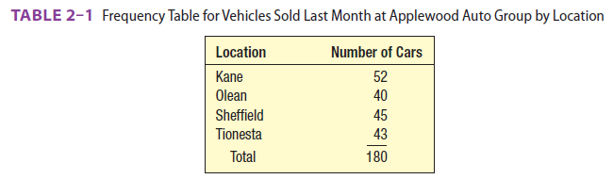
Constructing Frequency Tables
Mutually exclusive means the data fit in just one class
Collectively exhaustive means there is a class for each value
FREQUENCY TABLE A grouping of qualitative data into mutually exclusive and collectively exhaustive classes showing the number of observations in each class.
Notes:
Frequency tables are used in descriptive statistics to show the pattern of the data, identify where values tend to concentrate, and expose extreme or unusual values. Using the Applewood Auto Group data, the classes are each of the four dealerships.

Slide 37
Constructing Frequency Tables
To construct a frequency table
  First sort the data into classes
  Count the number in each class and report as the class frequency
Notes:
The relative frequency captures the relationship between a class frequency and the total number of observations. See Table 2-2. Microsoft Excel can create frequency tables with a tool called the Pivot Table. Instructions are given in Appendix C.

Slide 38
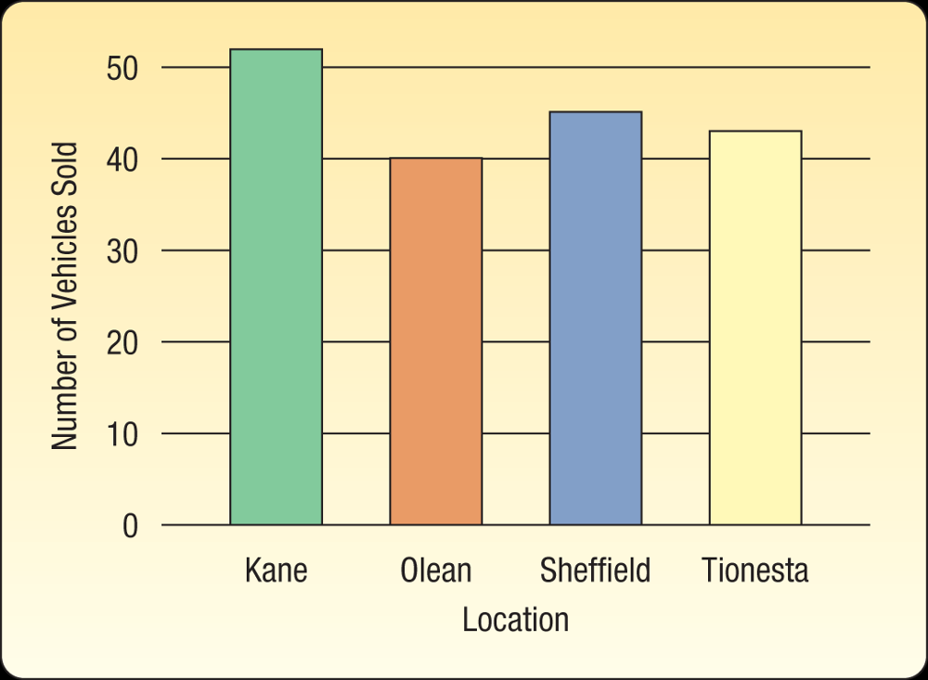
Graphic Presentation of Qualitative
Data
BAR CHART A graph that shows the qualitative classes on the horizontal axis and the class frequencies on the vertical axis. The class frequencies are proportional to the heights of the bars.
Use a bar chart when you wish to compare the number of observations for each class of a qualitative variable.
Notes:
Use a bar chart to graphically show the class frequencies. Excel software allows us to easily create bar charts. The instructions are in Appendix C.

Slide 39
Create Bar Chart or Other charts using excel.
Open Excel. ...
Select all the data that you want included in the bar chart. ...
Click the Chart Wizard toolbar button, or choose Chart from the Insert menu.
Make sure that Column is selected under Chart type (it's the default setting).
Select a subtype of bar graph from the display on the right, and click Next.

Slide 40
Constructing Relative Frequency Tables
Convert each frequency to a relative frequency
  Each of the class frequencies is divided by the total number of observations
  Shows the fraction of the total number observations in each class
Notes:
The relative frequency captures the relationship between a class frequency and the total number of observations. See Table 2-2. Microsoft Excel can create frequency tables with a tool called the Pivot Table. Instructions are given in Appendix C.

Slide 41
Relative class frequencies
You can convert class frequencies to relative class frequencies to show the fraction of the total number of observations in each class.
A relative frequency captures the relationship between a class frequency and the total number of observations.
In the vehicle sales example, we may want to know the percentage of total cars sold at each of the four locations.

Slide 42
Relative class frequencies
To convert a frequency table to a relative frequency table, each of the class frequencies is divided by the total number of observations.
Again, this is easily accomplished using Excel.
The fraction of vehicles sold last month at the Kane location is 0.289, found by 52 divided by 180. The relative frequency for each location is shown in table

Slide 43
Relative Frequency Table
RELATIVE FREQUENCY TABLE OF VEHICLES SOLD BY LOCATION LAST MONTH AT APPLEWOOD AUTO GROUP
Location | Number of Cars | Relative Frequency | Found by
Kane | 52 | .289 | 52/180
Olean | 40 | .222 | 40/180
Sheffield | 45 | .250 | 45/180
Tionesta | 43 | .239 | 43/180
Total | 180 | 1.000

Slide 44
Constructing Frequency Distributions
This is a four-step process
Decide on the number of classes
Determine the class interval
Set the individual class limits
Tally the data into classes and determine the number of the observations in each class
FREQUENCY DISTRIBUTION A grouping of quantitative data into mutually exclusive and collectively exhaustive classes showing the number of observations in each class.
Notes:
Earlier we used frequency tables for qualitative data. Now we learn how to present quantitative data; one technique for doing so is using frequency distributions.

Slide 45
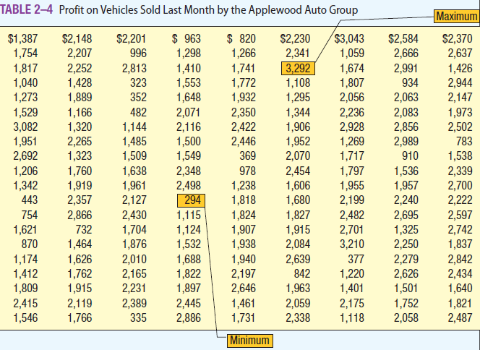
Frequency Distributions
Step 1 Decide on the number of classes
Use the 2^{k} > n rule, where n=180
  k is the number of classes
  n is the number of values in the data set
  2^{k} > 180, let k = 8
  So use 8 classes
Notes:
Examining the raw data in the table, we find there are 180 values, so n = 180. First try k=7, 2 to the 7th power only equals 128 and 128 is not greater than 180 so 7 classes will not meet the criteria. Then try k=8, 2 to the eighth power equals 256 so decide to use 8 classes since 256 > 180.

Slide 46

Frequency Distributions
  Step 2 Determine the class interval, i
  i ≥ (highest value – lowest value)/k
  Round up to some convenient number
  So decide to use an interval of $400
  The interval is also referred to as the class width
Notes:
After analyzing the table of raw data, you find the maximum value is $3,292 and the minimum value is $294, divide the difference by the number of classes. In this example, there are 8 classes so the result is $374.75. Round the result up to some convenient number like a multiple of 10 or 100, here we’ll use an interval of $400.

Slide 47
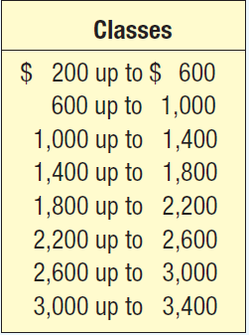
Frequency Distributions
Step 3 Set the individual class limits
  Lower limits should be rounded to an easy to read number when possible
Notes:
Make sure to use the words “up to” in each class in order to construct mutually exclusive classes; this will ensure each value in the data set fits in one and only one class. Also, check to see that the minimum value will go in the first class and the maximum value will go in the last class when setting class limits. Here the minimum value of $294 goes in the first class and the maximum value of $3,292 will go in the last class. This ensures you have exhaustive classes. Class midpoints can represent a typical value for each class and can be determined by adding the lower limits of consecutive classes and dividing by 2.

Slide 48
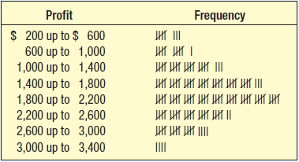
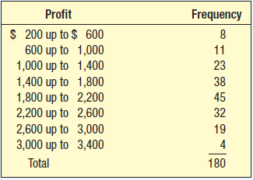
Frequency Distributions
Step 4 Tally the individual data into the classes and determine the number of observations in each class
  The number of observations is the class frequency
Notes:
There is some loss of detail when data is grouped but the frequency distribution results in an understandable and organized form. Equal class widths are preferred but might not always be possible.

Slide 49
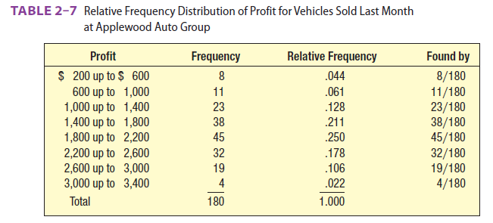
Relative Frequency Distributions
To find the relative frequencies, simply take the class frequency and divide by the total number of observations
Notes:
The relative class frequencies shows each class frequency relative to the entire distribution and adds up to 1.000.

Slide 50
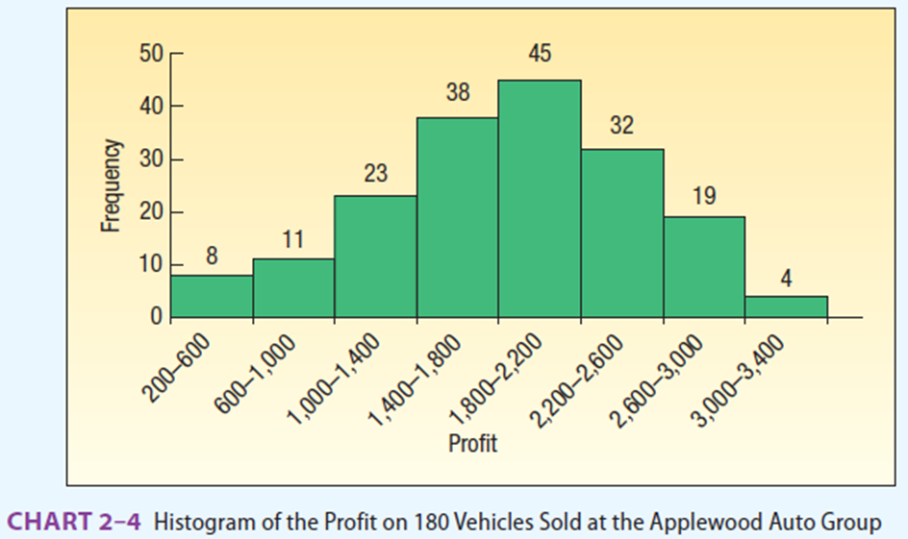
Graphic Presentation of a Frequency Distribution
HISTOGRAM A graph in which the classes are marked on the horizontal axis and the class frequencies on the vertical axis. The class frequencies are represented by the heights of the bars, and the bars are drawn adjacent to each other.
A histogram shows the shape of a distribution.
Each class is depicted as a rectangle, with the height of the bar representing the number in each class.
Notes:
Histograms allow us to get a quick picture of the main characteristics of the data. They are similar to bar charts but since this is continuous data there are no gaps between the bars, they are drawn adjacent to one another.

Slide 51
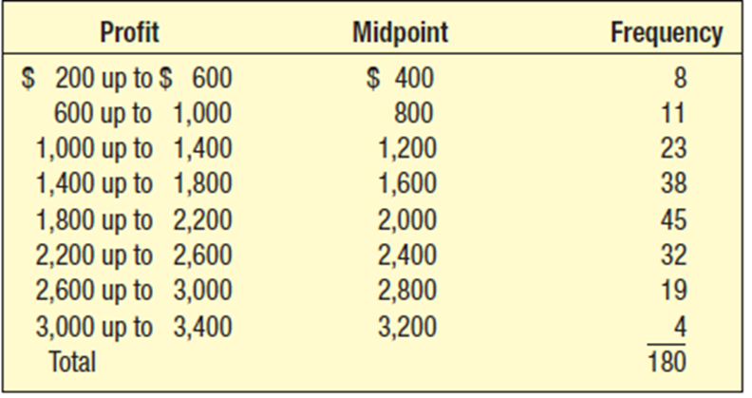
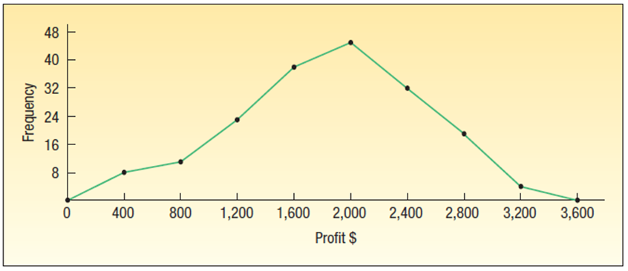
Graphical Presentation of a Frequency Distribution
A frequency polygon, similar to a histogram, also shows the shape of a distribution.
These are good to use when comparing two or more distributions.
Notes:
A frequency polygon consists of line segments connecting the points formed by the intersection of the class midpoints and the class frequencies. You may recall that class midpoints are halfway between the lower limits of two consecutive classes and represent the typical value for each class. Since the definition of a polygon is that it is a closed plane, the frequency polygon is closed by anchoring the connected line segments to the X axis at zero frequency one interval higher than the highest midpoint and one interval lower than the lowest midpoint.

Slide 52
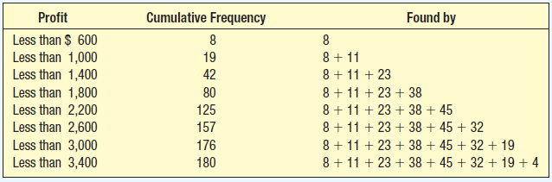
Cumulative Frequency Distributions
Notes:
To construct a cumulative frequency distribution, add each frequency to the frequencies before it. This shows how many values have accumulated as you move from one class down to the next class.

Slide 53
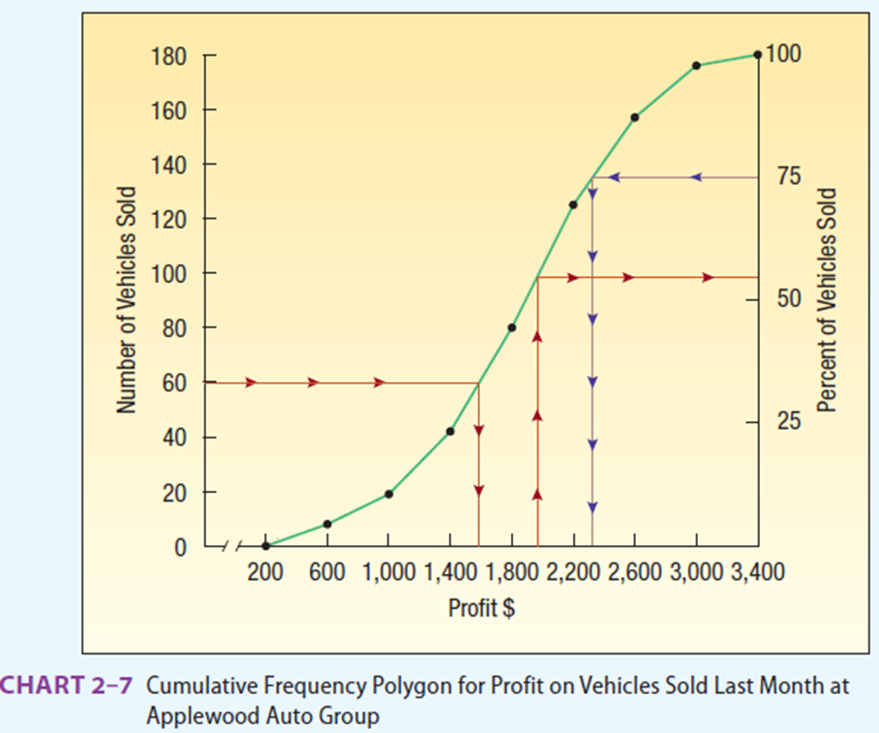
Cumulative Frequency Polygon
Notes:
To plot a cumulative frequency distribution, scale the upper limit of each class along the X-axis and the corresponding cumulative frequencies along the Y-axis. Label the vertical axis on the right in terms of cumulative relative frequencies.

Slide 54
The following is the number of minutes to commute from home to work for a group of 25 automobile executives.
28 25 48 37 41 19 32 26 16 23 23 29 36
31 26 21 32 25 31 43 35 42 38 33 28
How many classes would you recommend?
What class interval would you suggest?
What would you recommend as the lower limit of the first class?
Organize the data into a frequency distribution.
Comment on the shape of the frequency distribution.

Slide 55
How many classes would you recommend?
Use the 2^{k} > n rule, where n=25
  k is the number of classes
  n is the number of values in the data set
  2^{k} > 25, let k = 5 as k=4 is 16 and k=5 is 32
  So use 5 classes

Slide 56
What class interval would you suggest?
  I >= (48 – 16) /5 = 6.4 so 7
What would you recommend as the lower limit of the first class?
  15 as the lowest is 16 and one less will suffice

Slide 57
Organize the data into a frequency distribution.
  Class Frequency
  15 upto 22 3
  22 upto 29 8
  29 upto 36 7
  36 upto 43 5
  43 upto 50 2
  Total 25

Slide 58
CHAPTER SUMMARY
A frequency table is a grouping of qualitative data into mutually exclusive and collectively exhaustive classes showing the number of observations in each class.
A relative frequency table shows the fraction of the number of frequencies in each class.
A bar chart is a graphic representation of a frequency table.
A pie chart shows the proportion each distinct class represents of the total number of observations.

Slide 59
CHAPTER SUMMARY
A frequency distribution is a grouping of data into mutually exclusive and collectively exhaustive classes showing the number of observations in each class.
  The steps in constructing a frequency distribution are
    Decide on the number of classes.
    Determine the class interval.
    Set the individual class limits.
    Tally the raw data into classes and determine the frequency in each class.
  The class frequency is the number of observations in each class.
  The class interval is the difference between the limits of two consecutive classes.
  The class midpoint is halfway between the limits of consecutive classes.

Slide 60
CHAPTER SUMMARY
There are several methods for graphically portraying a frequency distribution.
  A histogram portrays the frequencies in the form of a rectangle or bar for each class. The height of the rectangles is proportional to the class frequencies.
  A frequency polygon consists of line segments connecting the points formed by the intersection of the class midpoint and the class frequency.
  A graph of a cumulative frequency distribution shows the number of observations less than a given value.
  A graph of a cumulative relative frequency distribution shows the percent of observations less than a given value.

Slide 61
Describing Data: Numerical Measures
Chapter 3
Notes:
In this chapter you will learn how to calculate measures of location and measures of dispersion. The purpose of a measure of location is to pinpoint the center of the data and these results are often referred to as averages. For example, the average US home changes ownership every 11.8 years and the average American home has more TV sets than people There are 2.73 TV sets and 2.55 people in the typical home. The dispersion in the data refers to the variation or spread in the data. For example, average incomes for two different industries may appear to be the same, but when the variation in the incomes from one industry to another is examined, you find there is much more variation in one than the other.

Slide 62
Learning Objectives
Compute and interpret
  the mean,
  the median, and
  the mode
Compute a weighted mean
Compute and interpret the geometric mean
Compute and interpret
  the range,
  variance, and
  standard deviation

Slide 63
Measures of Location
We begin by discussing measures of location.
The farthest one can reduce a set of data, and still retain any information at all, is to summarize the data with a single value.
Measures of location do just that:
They try to capture with a single number what is typical of the data. What single number is most representative of an entire list of numbers?
Notes:
When calculating a mean, there are different symbols to use when working with a population and when working with a sample. While the arithmetic mean is the most widely used measure of location, there are other means you will learn to calculate, namely, the weighted mean and the geometric mean. Later in the chapter, you learn to calculate an estimate of the mean of grouped data. And, there are other measures of central tendency too, like median and mode.

Slide 64
Measures of Location
There is not just one measure of location; in fact, there are many.
We will consider five:
the arithmetic mean,
the median,
the mode,
the weighted mean, and
the geometric mean.
Notes:
When calculating a mean, there are different symbols to use when working with a population and when working with a sample. While the arithmetic mean is the most widely used measure of location, there are other means you will learn to calculate, namely, the weighted mean and the geometric mean. Later in the chapter, you learn to calculate an estimate of the mean of grouped data. And, there are other measures of central tendency too, like median and mode.

Slide 65
Measures of Location
The arithmetic mean is the most widely used and widely reported measure of location.
We study the mean as both
  a population parameter and
  a sample statistic.
Notes:
When calculating a mean, there are different symbols to use when working with a population and when working with a sample. While the arithmetic mean is the most widely used measure of location, there are other means you will learn to calculate, namely, the weighted mean and the geometric mean. Later in the chapter, you learn to calculate an estimate of the mean of grouped data. And, there are other measures of central tendency too, like median and mode.

Slide 66
PRONUNCIATION KEY
SYMBOL | MEANING | PRONUNCIATION
μ | Population mean | mu
∑ | Operation of adding | sigma
∑x | Adding a group of values | sigma x
x¯x¯ | Sample mean | x bar
x¯wx¯w | Weighted mean | x bar sub w
GM | Geometric mean | G M
∑fM | Adding the product of the frequencies and the class midpoints | sigma f M
σ² | Population variance | sigma squared
σ | Population standard deviation | sigma

Slide 67
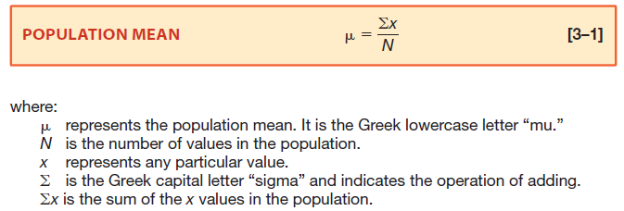
Population Mean
A measurable characteristic of a population is a parameter
PARAMETER A characteristic of a population.
Notes:
Here is the formula to calculate the population mean. For raw data, the population mean is calculated by adding the values of the observations and dividing by the total number of observations. These are population values because we are including all the values under consideration. An example of a population mean is the mean closing price for Johnson & Johnson stock for the last 5 days is $95.47. The mean of a population is an example of a parameter.

Slide 68

Example: Population Mean
There are 42 exits on I-75 through the state of Kentucky. Listed below are the distances between exits (in miles).
Why is this information a population?
What is the mean number of miles between exits?
Notes:
Perhaps you are interested in finding the average distance between exits on Interstate 75 in Kentucky. This data set lists the distances between all the exits along the Kentucky portion of the interstate.

Slide 69
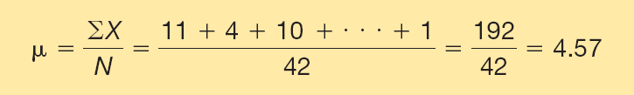
Example: Population Mean Continued
There are 42 exits on I-75 through the state of Kentucky. Listed below are the distances between exits (in miles).
Why is this information a population?
This is a population because we are considering all of the exits in Kentucky.
What is the mean number of miles between exits?
Notes:
We interpret the value 4.57 as the typical number of miles between exits. This value is a population parameter.

Slide 70
As explained in Chapter 1, we often select a sample from the population to estimate a specific characteristic of the population.
Business Situation: Smucker’s quality assurance department needs to be assured that the amount of orange marmalade in the jar labeled as containing 12 ounces actually contains that amount. It would be very expensive and time-consuming to check the weight of each jar.
Therefore, a sample of 20 jars is selected, the mean of the sample is determined, and that value is used to estimate the amount in each jar.

Slide 71
For raw data—that is, ungrouped data—the mean is the sum of all the sampled values divided by the total number of sampled values. To find the mean for a sample:
Sample mean = Sum of all the values in the sample
Number of values in the sample
The mean of a sample and the mean of a population are computed in the same way, but the shorthand notation used is different. The formula for the mean of a sample is:

Slide 72
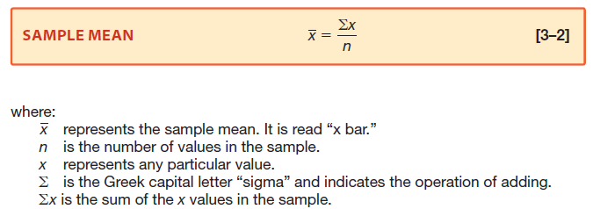
Sample Mean
A measurable characteristic of a sample is a statistic
STATISTIC A characteristic of a sample.
Notes:
The formula we use to calculate the sample mean is on this slide. For raw data, the mean of a sample is the sum of all the sampled values divided by the total number of sampled values. To save time and money, we often select a sample from a population to estimate characteristics of the population. An example is taking a sample of 20 jars of Smucker’s orange marmalade and weighing the 20 jars, calculating the mean weight. Then we can use that value to estimate the amount for all the jars in the population. The mean of a sample is a statistic.

Slide 73
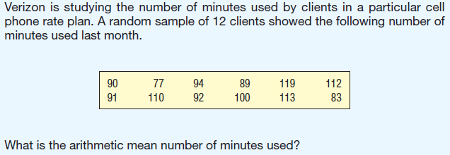
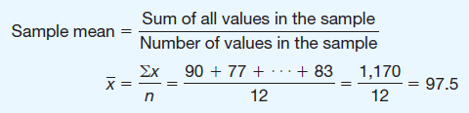
Example: Sample Mean
Notes:
We interpret 97.5 minutes as the typical number of minutes used last month. This value is a sample statistic.

Slide 74
Properties of the Arithmetic Mean
Interval or ratio scale of measurement is required
  Recall from Chapter 1 that ratio-level data include such data as ages, incomes, and weights, with the distance between numbers being constant.
All the data values are used in the calculation
It is unique
  That is, there is only one mean in a set of data.
The sum of the deviations from the mean equals zero
A weakness of the mean is that it is affected by extreme values
Notes:
Listed here are the major characteristics of the arithmetic mean. If one or two of the values in the data set are extremely large or small compared to the majority of the data, the mean may not be representative of the data set and therefore may not be the best “average” to use and you may chose to use another measure of location like median or mode to represent the data.

Slide 75
The sum of the deviations from the mean equals zero
Expressed symbolically:
Σ(x−x¯)=0
As an example, the mean of 3, 8, and 4 is 5. Then:
Σ(x−x¯)=(3−5)+(8−5)+(4−5)
= −2+3−1
= 0

Slide 76
The annual incomes of a sample of middle-management employees at Westinghouse are $62,900, $69,100, $58,300, and $76,800.
(a) Give the formula for the sample mean.
(b) Find the sample mean.
(c) Is the mean you computed in (b) a statistic or a parameter? Why?
(d) What is your best estimate of the population mean?
The six students in Computer Science 411 are a population. Their final course grades are 92, 96, 61, 86, 79, and 84.
(a) Give the formula for the population mean.
(b) Compute the mean course grade.
(c) Is the mean you computed in (b) a statistic or a parameter? Why?

Slide 77
Answers
267,100 /4 = 66,775
Statistics because it is a sample value
66,775 the sample mean is our best estimate of population mean

Slide 78
Answers
408 / 6 = 83
Parameter since it was computer using all values.

Slide 79
The Median
MEDIAN The midpoint of the values after they have been ordered from the minimum to the maximum values.
Prices Ordered from Minimum to Maximum |  | Prices Ordered from Maximum to Minimum
$ 60,000 |  | $ 275,000
65,000 |  | 80,000
70,000 | Median | 70,000
80,000 |  | 65,000
275,000 |  | 60,000
Notes:
The median is the value in the middle of a set of ordered data and is often used to describe data sets where there are one or just a few extreme values such as with real estate prices or household incomes in a particular area. Here are prices for condos in Palm Aire with an arithmetic mean price of $110,000. A better measure would be the median since it, $70,000, is not affected by the $275,000 unit. When finding the median, it doesn’t matter if the values are sorted in ascending order or descending order. Since there are an odd number of values in this data set it is fairly easy to find the value that divides the set in half, with the same number of observations below $70,000 as above $70,000. Remember, the data must be at least the ordinal level of measurement.

Slide 80
Characteristics of the Median
The median is the value in the middle of a set of ordered data
At least the ordinal scale of measurement is required
It is not influenced by extreme values
Fifty percent of the observations are larger than the median
It is unique to a set of data
Notes:
In cases where the mean is not representative of the data, you may decide to use the median.

Slide 81
Finding the Median
To find the median for an even numbered data set
Sort the observations and calculate the average of the two middle values
The number of hours a sample of 10 adults used Facebook last month:
3 5 7 5 9 1 3 9 17 10
Arranging the data in ascending order gives:
1 3 3 5 5 7 9 9 10 17
Thus, the median is 6.
Notes:
To find the median for an even number of observations, first order the values, then calculate the mean of the two middle values. For an even number of observations, the median may not be one of the given values.

Slide 82
A sample of single persons in Towson, Texas, receiving Social Security payments revealed these monthly benefits: $852, $598, $580, $1,374, $960, $878, and $1,130.
  (a) What is the median monthly benefit?
  (b) How many observations are below the median? Above it?
The number of work stoppages in the United States over the last 10 years are 22, 20, 21, 15, 5, 11, 19, 19, 15, and 11.
  (a) What is the median number of stoppages?
  (b) How many observations are below the median? Above it?

Slide 83
878
3, 3
17 (15 + 19)/2 = 17
5, 5

Slide 84
The Mode
Major Characteristics of the mode:
  The mode can be found for nominal level data
  A set of data can have more than one mode
  As an example of its use for nominal-level data, a company has developed five bath oils. The bar chart shows the results of a marketing survey designed to find which bath oil consumers prefer. The largest number of respondents favored Lamoure, as evidenced by the highest bar. Thus, Lamoure is the mode.
MODE The value of the observation that occurs most frequently.
Notes:
The mode is useful for summarizing nominal level data. Here a company has developed five bath oils and has conducted a marketing survey to find which bath oil consumers prefer. We see that most of the survey respondents favored Lamoure since it is the highest bar. So Lamoure is the mode. Mode can be determined for all levels of measurement and it is not affected by extreme values. A disadvantage of using the mode is that a data set may not have a mode or that it has more than one mode.

Slide 85
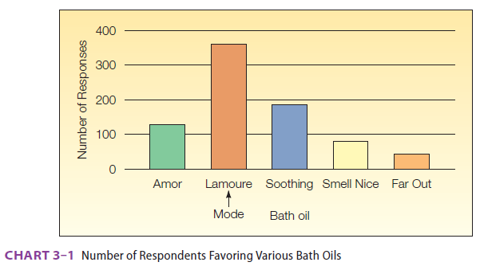
The Mode
MODE The value of the observation that occurs most frequently.
Notes:
The mode is useful for summarizing nominal level data. Here a company has developed five bath oils and has conducted a marketing survey to find which bath oil consumers prefer. We see that most of the survey respondents favored Lamoure since it is the highest bar. So Lamoure is the mode. Mode can be determined for all levels of measurement and it is not affected by extreme values. A disadvantage of using the mode is that a data set may not have a mode or that it has more than one mode.

Slide 86
In summary, we can determine the mode for all levels of data—nominal, ordinal, interval, and ratio. The mode also has the advantage of not being affected by extremely high or low values.
The mode does have disadvantages, however, that cause it to be used less frequently than the mean or median.
For many sets of data, there is no mode because no value appears more than once.
For example, there is no mode for this set of price data because every value occurs once: $19, $21, $23, $20, and $18.

Slide 87
Conversely, for some data sets there is more than one mode.
Suppose the ages of the individuals in a stock investment club are 22, 26, 27, 27, 31, 35, and 35. Both the ages 27 and 35 are modes. Thus, this grouping of ages is referred to as bimodal (having two modes). One would question the use of two modes to represent the location of this set of age data.

Slide 88

The Weighted Mean
The weighted mean is found by multiplying each observation, x, by its corresponding weight, w
The Carter Construction Company pays its hourly employees $16.50, $19.00, or $25.00 per hour. There are 26 hourly employees: 14 are paid at the $16.50 rate, 10 at the $19.00 rate, and 2 at the $25.00 rate.
What is the mean hourly rate paid for the 26 employees?
Notes:
Here is the formula for calculating the weighted mean. You’ll discover that this is really just a short cut method of computing the arithmetic mean which we can use when we have recurring values in a data set. The mean hourly rate is $18.12

Slide 89
Springers sold 95 Antonelli men’s suits for the regular price of $400. For the spring sale, the suits were reduced to $200 and 126 were sold. At the final clearance, the price was reduced to $100 and the remaining 79 suits were sold.
What was the weighted mean price of an Antonelli suit?
$ 237
(95x400) + (126x200) + (79x100) /95+126+79 = 237

Slide 90
Springers sold 95 Antonelli men’s suits for the regular price of $400. For the spring sale, the suits were reduced to $200 and 126 were sold. At the final clearance, the price was reduced to $100 and the remaining 79 suits were sold.
Springers paid $200 a suit for the 300 suits. Comment on the store’s profit per suit if a salesperson receives a $25 commission for each one sold.
The profit per suit is 12 dollars.
237 – 200 – 25 = 12
Total profit 300 x 12 = 3600

Slide 91
In June, an investor purchased 300 shares of Oracle (an information technology company) stock at $20 per share. In August, she purchased an additional 400 shares at $25 per share. In November, she purchased an additional 400 shares, but the stock declined to $23 per share. What is the weighted mean price per share?

Slide 92
$ 22.91
(300 x 20) + (400 x 25) + (400 x 23)/300+400+400 = 22.91
6000+10000+9200 = 25200
25200/1100 = 22.91

Slide 93

The Geometric Mean
The geometric mean is the nth root of the product of n positive values
The formula for geometric mean is
The geometric mean is also used to find the rate of change from one period to another
Notes:
Here are the formulas to calculate the geometric mean and to find the rate of change over time. The geometric mean is always equal to or less than the arithmetic mean.

Slide 94
Measure of Dispersion:
A measure of location, such as the mean, median, or mode, only describes the center of the data. It is valuable from that standpoint, but it does not tell us anything about the spread of the data.
For example, if your nature guide told you that the river ahead averaged 3 feet in depth, would you want to wade across on foot without additional information?
Probably not. You would want to know something about the variation in the depth. Is the maximum depth of the river 3.25 feet and the minimum 2.75 feet? If that is the case, you would probably agree to cross. What if you learned the river depth ranged from 0.50 foot to 5.5 feet?
Your decision would probably be not to cross. Before making a decision about crossing the river, you want information on both the typical depth and the dispersion in the depth of the river.

Slide 95
Why Study Dispersion?
The dispersion is the variation or spread in a set of data
The range is the difference between the maximum and minimum values in a set of data
The formula for range is
The major characteristics of the range are
  Only two values are used in its calculation
  It is influenced by extreme values
  It is easy to compute and to understand
Notes:
A measure of location only describes the center of the data; it does not tell us anything about the spread of the data, we may need to know something about the variation in the data. Measures of dispersion also allows us to compare two or more distributions. Small measures of dispersion indicates the data are closely clustered around the mean and therefore the mean is representative of the data; large measures of dispersion indicates that the mean may not be representative of the data. We’ll learn how to compute the range, the variance, and the standard deviation as well as the major characteristics of each.

Slide 96
Variance
A limitation of the range is that it is based on only two values, the maximum and the minimum; it does not take into consideration all of the values. The variance does. It measures the mean amount by which the values in a population, or sample, vary from their mean. In terms of a definition:
VARIANCE The arithmetic mean of the squared deviations from the mean.
The following example illustrates how the variance is used to measure dispersion.

Slide 97
Business Situation # 1
Calculate the (a) range, (b) arithmetic mean, (c) variance, and (d) interpret the statistics.
During last weekend’s sale, there were five customer service representatives on duty at the Electronic Super Store. The numbers of HDTVs these representatives sold were 5, 8, 4, 10, and 3.

Slide 98
Range: Highest value – Lowest value
10 – 3 = 7
Mean: 5 + 8 + 4 +10 + 3 = 30/5 = 6
Variance: = Variance=Σ(x−μ)² / N
(5-6)² + (8-6)² + (4-6)² + (10-6)² + (3-6)²
(1 + 4 + 4 + 16 + 9)/5
34/5 = 6.8
The difference between the highest number sold (10) and the lowest number sold (3) is 7. The typical squared deviation from 6 is 6.8.

Slide 99
Business Situation # 2
Calculate the (a) range, (b) arithmetic mean, (c) variance, and (d) interpret the statistics.
Dave’s Automatic Door installs automatic garage door openers. The following list indicates the number of minutes needed to install 10 door openers: 28, 32, 24, 46, 44, 40, 54, 38, 32, and 42.

Slide 100
Range: Highest value – Lowest value
54 – 24 = 30
Mean: 38 found by 380/10
Variance: = Variance=Σ(x−μ)² / N
74.4 found by 744/10
The difference between the highest number sold (54) and the lowest number sold (24) is 30. The typical squared deviation from 38 is 74.4

Slide 101
Business Situation # 3
Calculate the (a) range, (b) arithmetic mean, (c) variance, and (d) interpret the statistics.
Ten young adults living in California rated the taste of a newly developed sushi pizza topped with tuna, rice, and kelp on a scale of 1 to 50, with 1 indicating they did not like the taste and 50 that they did. The ratings were:
34 39 40 46 33 31 34 14 15 45
In a parallel study, 10 young adults in Iowa rated the taste of the same pizza. The ratings were:
28 25 35 16 25 29 24 26 17 20
As a market researcher, compare the potential for sushi pizza in the two markets.

Slide 102
State Mean Median Range
California 33.10 34 32
Iowa 24.50 25 19

Slide 103
Example 4-3: Calculating the SD of a list
data 3 0 6 4 5 2
The mean of the list is
3+0+6+4+5+26=3.33.
The list of deviations from the mean is
{(3−3.33),(0−3.33),(6−3.33),(4−3.33),(5−3.33),(2−3.33)}
={−0.33,−3.33,2.67,0.67,1.67,−1.33}.
The SD is the rms of this list of deviations from the mean:
SD=(−0.33)2+(−3.33)2+2.672+0.672+1.672+(−1.33)26−−−−−−−−−−−−−−−−−−−−−−−−−−−−−−−−−−−−−−−−−−−−√
=23.336−−−−−√
=1.97.

Slide 104

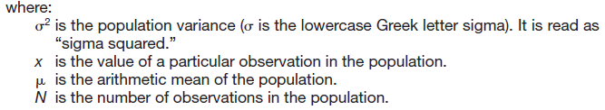
Population Variance
Major characteristics of the variance are:
  All observations are used in the calculation
  The units are somewhat difficult to work with, they are the original units squared
Notes:
The formula for determining the population variance is shown above and is another measure of dispersion. The variance is the mean of the squared deviations from the arithmetic mean.

Slide 105
The process for computing the variance:
Begin by finding the mean.
Find the difference between each observation and the mean, and square that difference.
Sum all the squared differences.
Divide the sum of the squared differences by the number of items in the population.

Slide 106
The process for computing the variance:
So the population variance is the mean of the squared difference between each value and the mean.
For populations whose values are near the mean, the variance will be small. For populations whose values are dispersed from the mean, the population variance will be large.
The variance overcomes the weakness of the range by using all the values in the population, whereas the range uses only the maximum and minimum values.
We overcome the issue where ∑(x − μ) = 0 by squaring the differences. Squaring the differences will always result in nonnegative values.

Slide 107
The following is another example that illustrates the calculation and interpretation of the variance.
The number of traffic citations issued last year by month in
Beaufort County, South Carolina, is reported below.
Determine the population variance.
Citations by Month
January | February | March | April | May | June | July | August | September | October | November | December
19 | 17 | 22 | 18 | 28 | 34 | 45 | 39 | 38 | 44 | 34 | 10

Slide 108
Because we are studying all the citations for a year, the data comprise a population. To determine the population variance, we use formula (3–7). The table below details the calculations.

Slide 109
Citations
Month | (x) | x − μ | (x − μ)²
January | 19 | −10 | 100
February | 17 | −12 | 144
March | 22 | −7 | 49
April | 18 | −11 | 121
May | 28 | −1 | 1
June | 34 | 5 | 25
July | 45 | 16 | 256
August | 39 | 10 | 100
September | 38 | 9 | 81
October | 44 | 15 | 225
November | 34 | 5 | 25
December | 10 | −19 | 361
Total | 348 | 0 | 1,488

Slide 110
Variance: = Variance=Σ(x−μ)² / N

Slide 111

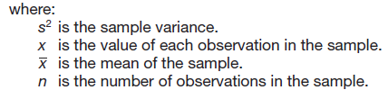
Sample Variance
Notes:
We remember variance is the mean of the squared deviations from the arithmetic mean. Here is the formula for sample variance. Like the population variance, all the observations in the sample are used. The units are somewhat difficult to work with since they are the original units squared. The variance is useful when comparing two different data sets, the one with the higher variance has more variation in it than the other.

Slide 112
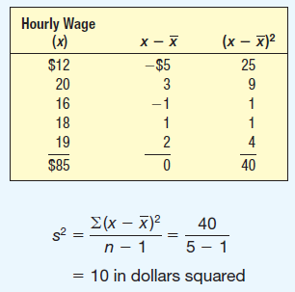
Example: Sample Variance
The hourly wages for a sample of 5 part-time employees at Home Depot are: $12, $20, $16, $18, and $19.
The sample mean is $17.
What is the sample variance?
Notes:
The sample variance is used to estimate the population variance. Notice the change in the denominator. Rather than use n, we use n – 1 so that we do not underestimate the population variance.

Slide 113

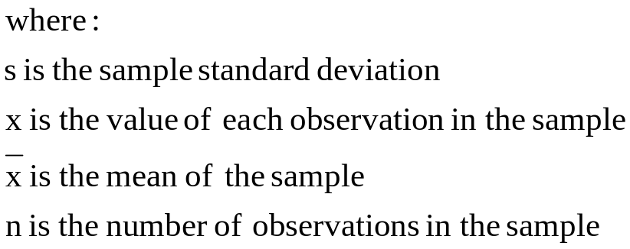
Standard Deviation
Notes:
The formula for sample standard deviation is simply the square root of the variance and the symbol, x bar represents sample standard deviation.
Likewise, the population standard deviation (not shown) is the square root of the population variance and uses the Greek symbol sigma.
The standard deviation is the most widely reported measure of dispersion.

Slide 114
The Philadelphia office of PricewaterhouseCoopers hired five accounting trainees this year. Their monthly starting salaries were $3,536; $3,173; $3,448; $3,121; and $3,622.
(a) Compute the population mean.
(b)Compute the population variance.
(c)Compute the population standard deviation.

Slide 115
The Philadelphia office of PricewaterhouseCoopers hired five accounting trainees this year. Their monthly starting salaries were $3,536; $3,173; $3,448; $3,121; and $3,622.
Compute the population mean.
16900/5 = 3380
(b)Compute the population variance.
$σ$² = (156)² + (-207)² + (68)² + (-259)² + (242)² = 197454/5 = 39490.8
$σ$² = 39490.8
(c)Compute the population standard deviation.
$σ$= square root of 39490.8 which is 198.72

Slide 116
Standard Deviation
The major characteristics of the standard deviation are:
  It is in the same units as the original data
  It is the square root of the average squared distance from the mean
  It cannot be negative
  It is the most widely used measure of dispersion
Notes:
These properties are useful for understanding both population standard deviations and sample standard deviations.

Slide 117
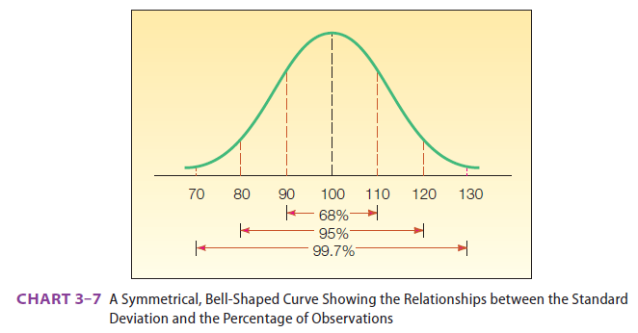
Interpretations and Uses of the Standard Deviation
THE EMPIRICAL RULE For a symmetrical, bell-shaped frequency distribution, approximately 68% of the observations will lie within plus and minus one standard deviation of the mean, about 95% of the observations will lie within plus or minus 2 standard deviations of the mean, and practically all (99.7%) will lie within 3 standard deviations of the mean.
Notes:
If we have a symmetrical distribution we can use the Empirical Rule, sometimes called the Normal Rule, which allows us to be more precise than with Chebyshev’s Theorem. Here is a symmetrical distribution with a mean of 100 and a standard deviation of 10. Applying the Empirical Rule, we’ll find about 68% of the values between 90 and 110, about 95% of the values between 80 and 120, and about 99.7% of the values between 70 and 130.

Slide 118
Ethics and Reporting Results
Useful to know the advantages and disadvantages of mean, median, and mode as we report statistics and as we use statistics to make decisions
Important to maintain an independent and principled point of view
Statistical reporting requires objective and honest communication of any results

Slide 119
The Relative Positions of the Mean, Median, and Mode
Refer to the histogram below. It is a symmetric distribution, which is also mound-shaped. This distribution has the same shape on either side of the center. If the histogram were folded in half, the two halves would be identical. For any symmetric distribution, the mode, median, and mean are located at the center and are always equal. They are all equal to 30 years. We should point out that there are symmetric distributions that are not mound-shaped.

Slide 120

Interpretations and Uses of the Standard Deviation
CHEBYSHEV’S THEOREM For any set of observations (sample or population), the proportion of the values that lie within k standard deviations of the mean is at least 1 – 1/k², where k is any value greater than 1.
The arithmetic mean biweekly amount contributed by the Dupree Paint employees to the company’s profit-sharing plan is $51.54, and the standard deviation is $7.51. At least what percent of the contributions lie within plus 3.5 standard deviations and minus 3.5 standard deviations of the mean?
Notes:
We can use the standard deviation to describe a distribution. The Russian mathematician, P. L. Chebyshev developed a theorem that allows us to determine the minimum proportion of values that lie within a specified number of standard deviations of the mean. For example, consider 2 standard deviations, we find that 1 – 1/2² = .75 so a minimum of 75% of values lie within the mean. This theorem can be used regardless of the shape of the distribution.

Slide 121
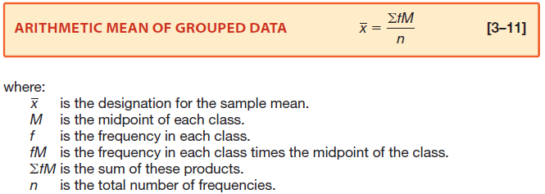
Sample Mean of Grouped Data
Notes:
This formula is used to find an estimated mean of data in a frequency distribution; once the data has been grouped in classes, individual values are no longer available.
Letting the midpoint of each class represent the values in each group, multiply the midpoint by the class frequency for each group, sum these products, and
then divide by the total number of frequencies. See table 3-1 in the text for more detail.

Slide 122
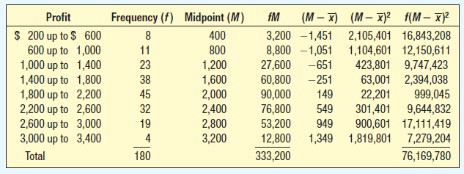

Calculating the Standard Deviation of Grouped Data
Applewood Auto Group Frequency Distribution Compute the standard deviation of the vehicle profits.
Notes:
To calculate the standard deviation of grouped data, begin by estimating the mean (in this example the mean is $1,851), then find the deviation of each value from the midpoint,
square the results in this column and then multiply by the class frequency. Divide the sum of these products and divide by n-1 and finally, take the square root of that calculation.

Slide 123
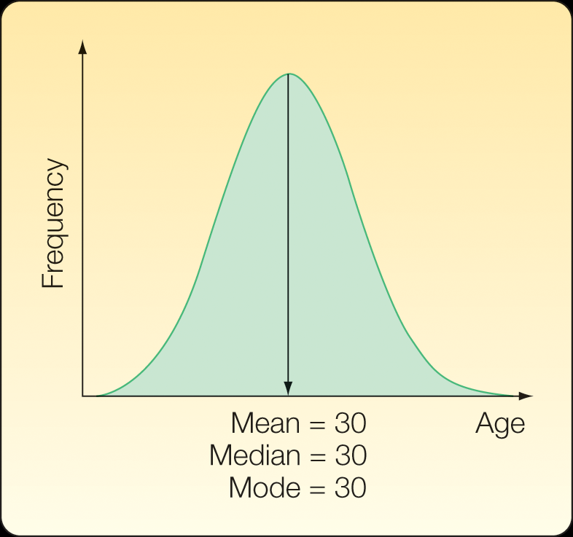
Relative Positions of Mean, Median, and Mode
A Symmetric Distribution
Notes:
Refer to the first chart on the left. It is a symmetric distribution with zero skewness where the mean=median=mode. The middle chart is positively skewed because the mode<median<mean and it has a tail on the right. In the last chart, the mean<median<mode and is negatively skewed with a tail to the left. If a distribution is highly skewed, the mean is probably not a representative measure of central tendency and the median or mode should be used.

Slide 124
The number of years corresponding to the highest point of the curve is the mode (30 years). Because the distribution is symmetrical, the median corresponds to the point where the distribution is cut in half (30 years). Also, because the arithmetic mean is the balance point of a distribution (as shown in the Properties of the Arithmetic Mean section), and the distribution is symmetric, the arithmetic mean is 30. Logically, any of the three measures would be appropriate to represent the distribution’s center.

Slide 125
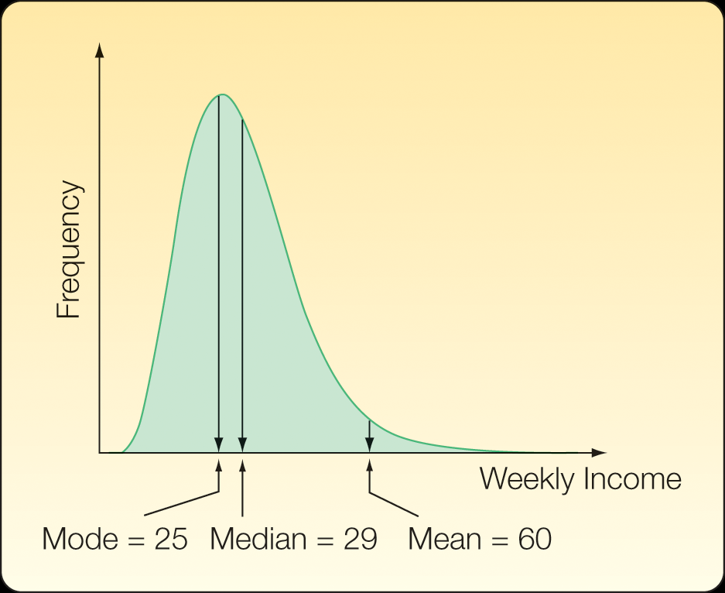
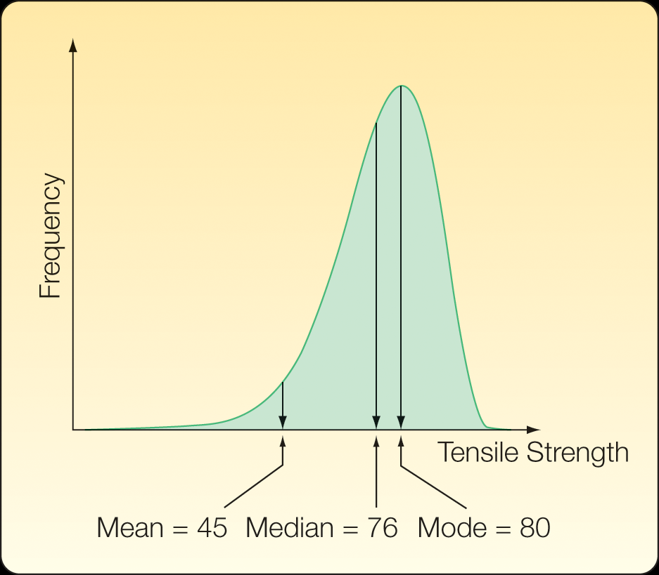
Relative Positions of Mean, Median, and Mode
Chart 3-2 A Symmetric Distribution
Chart 3-3 A Positively Skewed Distribution
Chart 3-4 A Negatively Skewed Distribution
Notes:
Refer to the first chart on the left. It is a symmetric distribution with zero skewness where the mean=median=mode. The middle chart is positively skewed because the mode<median<mean and it has a tail on the right. In the last chart, the mean<median<mode and is negatively skewed with a tail to the left. If a distribution is highly skewed, the mean is probably not a representative measure of central tendency and the median or mode should be used.

Slide 126
Describing Data: Displaying and Exploring Data
Notes:
This chapter continues our study of descriptive statistics with dot plots, stem-and-leaf displays, percentiles, and box plots. These charts and statistics will give us additional insight about where the data is concentrated as well as the general shape of the data. Later, bivariate data is examined. Studying this chapter will give us experience with business analytics.

Slide 127
Learning Objectives
Construct and interpret a dot plot
Construct and describe a stem-and-leaf display
Identify and compute measures of position
Construct and analyze a box plot
Compute and interpret the coefficient of skewness
Develop and explain a contingency table

Slide 128
So Far
In order to transform raw or ungrouped data into a meaningful form, we organize the data into a frequency distribution. We present the frequency distribution in graphic form as a histogram. This allows us to visualize where the data tend to cluster, the largest and the smallest values, and the general shape of the data.
Then we computed several measures of location, such as the mean, median, and mode. These measures of location allow us to report a typical value in the set of observations. We also computed several measures of dispersion, such as the range, variance, and standard deviation. These measures of dispersion allow us to describe the variation or the spread in a set of observations.

Slide 129
So Far
We continue our study of descriptive statistics.
We study
(1) dot plots,
(2) stem-and-leaf displays,
(3) percentiles, and
(4) box plots. These charts and statistics give us additional insight into where the values are concentrated as well as the general shape of the data.

Slide 130
So Far
We continue our study of descriptive statistics.
Then we consider bivariate data.
In bivariate data, we observe two variables for each individual or observation.

Slide 131
So Far
Examples include:
The number of hours a student studied and the points earned on an examination;
If a sampled product meets quality specifications and the shift on which it is manufactured;
The amount of electricity used in a month by a homeowner and the mean daily high temperature in the region for the month.
These charts and graphs provide useful insights as we use business analytics to enhance our understanding of data.

Slide 132
Dot Plot: Definition
A Dot Plot, also called a dot chart or strip plot, is a type of simple histogram like chart used in statistics for relatively small data sets where values fall into a number of discrete categories.
A dot plot is similar to a bar graph because the height of each “bar” of dots is equal to the number of items in a particular category.
To draw a dot plot, count the number of data points falling in each category and draw a stack of dots that number high for each bin.

Slide 133
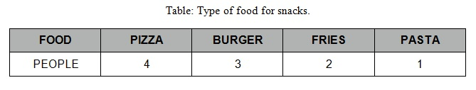
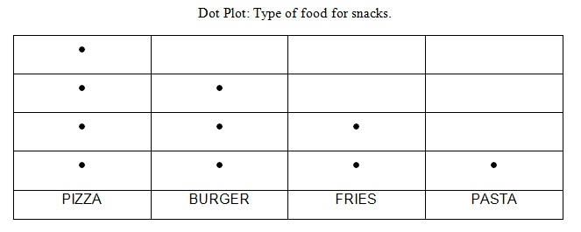
A good example would be the choice of foods that you and your friends ate for snacks In a table chart it looks like this:
In a Dot Plot, it looks like this:

Slide 134
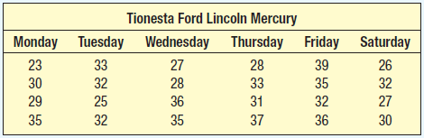
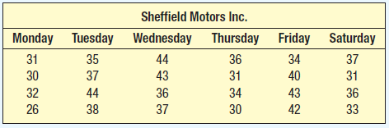
Dot Plots Example
Use dot plots to compare the two data sets like these of the number of vehicles serviced last month for two different dealerships
Notes:
Dot plots are useful for comparing two different data sets. Here are tables with the number of vehicles serviced by two of the dealerships owned by the Applewood Auto Group. We will use dot plots to show the difference in location and dispersion of the observations. To develop a dot plot we display a dot for each observation along a horizontal number line. If there are identical values, the dots are piled on top of each other.

Slide 135
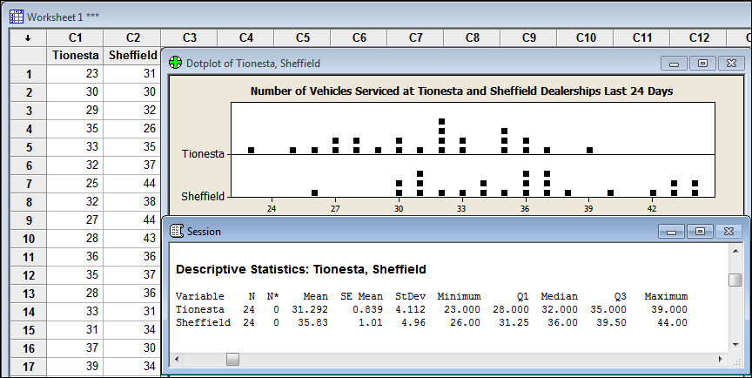
Dot Plots Example
Minitab provides dot plots and summary statistics
Notes:
These dot plots of data from two dealerships owned by the Applewood Auto Group show the difference in location and dispersion of the observations. We can clearly see the number of vehicles serviced at the Sheffield dealership is more widely dispersed and has a larger mean than at the Tionesta dealership. Notice the identities of the individual values has not been lost.

Slide 136
Stem-and-Leaf Displays
An alternative to a frequency distribution and histogram
The advantages of the stem-and-leaf display
  The identity of each observation is not lost
  The digits themselves give a picture of the distribution
  The cumulative frequencies are also shown
STEM-AND-LEAF DISPLAY A statistical technique to present a set of data. Each numerical value is divided into two parts. The leading digit becomes the stem and the trailing digit the leaf. The stems are located along the vertical axis, and the leaf values are stacked against each other along the horizontal axis.
Notes:
Stem-and-leaf displays are easy to use especially when performing a quick analysis of a small data set.

Slide 137
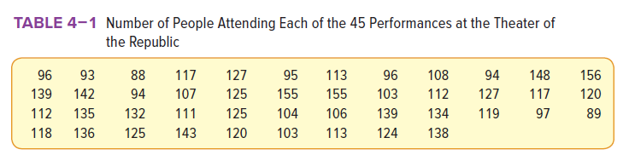
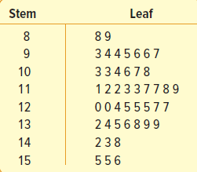
Stem-and-Leaf Display Example
Notes:
Stem-and-Leaf Displays provides an alternative to frequency distributions and histograms. Table 4-1 shows the number of people attending 45 performances at the Theater of the Republic. Note, the smallest attendance is 88, so the first stem is 8. The largest attendance is 156, so the largest stem will be 15. The first number in the table is 96, so 9 is the stem and 6 is the leaf. The next number is 93, so a three is placed after the 6 and so on. It is customary to sort the leaf values from smallest to largest. It is easy to see the minimum value, the maximum value and how many times the number of people attending the performances was more than 150 and so on. Minitab can produce stem-and-leaf displays too.

Slide 138

Measures of Position
Measures of location also describes the shape of the distribution and can be expressed as percentiles
Quartiles divide a set of observations into four equal parts
  The interquartile range is the difference between the third quartile and the first quartile
Deciles divide a set of observations into 10 equal parts
Percentiles divide a set of observations into 100 equal parts
Notes:
The standard deviation is the most widely used measure of dispersion but another method of describing dispersion is with measures of location. Here is the formula that can be used to find any percentile where p represents percentile and n is the number of values in the data set. To find the first quartile, Q1, use 25 as the percentile and to find the third quartile use 75. Use this formula to find the median, or Q2, using 50 as the percentile. The data must be ordered from smallest to largest.
Quartiles, deciles and percentiles are commonly used measures of location. 25% of the data is less than the 1st quartile, 50% of the data is less than the 2nd quartile, and 75% of the data is less than the 3rd quartile. The interquartile range covers the middle 50% of the data.

Slide 139
Measures of Position Example
Morgan Stanley is an investment company with offices located throughout the United States. Listed below are the commissions earned last month by a sample of 15 brokers.
First, sort the data from smallest to largest
$2,038 | $1,758 | $1,721 | $1,637 | $2,097 | $2,047 | $2,205 | $1,787 | $2,287
1,940 | 2,311 | 2,054 | 2,406 | 1,471 | 1,460
$1,460 | $1,471 | $1,637 | $1,721 | $1,758 | $1,787 | $1,940 | $2,038
2,047 | 2,054 | 2,097 | 2,205 | 2,287 | 2,311 | 2,406

Slide 140
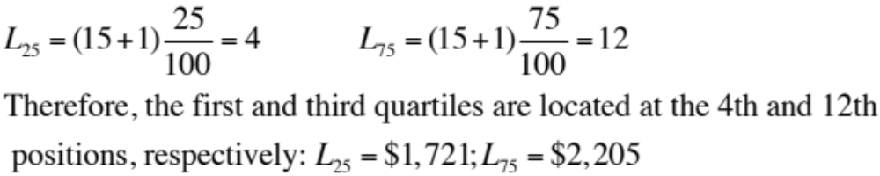
Measures of Position Example
Next, find the median
L₅₀ = (15+1)*50/100 = 8
So the median is $2,038, the value at position 8
$1,460 | $1,471 | $1,637 | $1,721 | $1,758 | $1,787 | $1,940 | $2,038
2,047 | 2,054 | 2,097 | 2,205 | 2,287 | 2,311 | 2,406
Notes:
The median is the same as the 50th percentile.
The first quartile, Q1, L25 = (15+1)*25/100 = 4 so Q1=$1,721, the 4th value.
The third quartile, Q3 is the 75th percentile, L₇₅ = (15+1)*75/100 = 12, so Q3 is $2,205, the 12th value.

Slide 141
Box Plots
A box plot is a graphical display using quartiles
A box plot is based on five statistics:
  Minimum value
  1st quartile
  Median
  3rd quartile
  Maximum value
The interquartile range is Q3 – Q1
Outliers are values that are inconsistent with the rest of the data and are identified with asterisks in box plots
Notes:
Begin by drawing a number line that will accommodate the minimum and maximum values. Then draw a vertical line above the median, Q1, and Q3. Enclose the regions between the first and third quartile creating the box. Next, draw dotted line segments from the third quartile to the largest value and from the first quartile to the smallest value. This shows the largest 25% and smallest 25% respectively. The interquartile range is the middle 50% of the data.

Slide 142
Box Plot Example
Alexander’s Pizza offers free delivery of its pizza within 15 miles. How long does a typical delivery take? Within what range will most deliveries be completed?
Using a sample of 20 deliveries, Alexander determined the following:
  Minimum value = 13 minutes
  Q1 = 15 minutes
  Median = 18 minutes
  Q3 = 22 minutes
  Maximum value = 30 minutes
Develop a box plot for delivery times

Slide 143
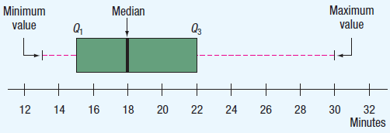
Box Plot Example Continued
Begin by drawing a number line using an appropriate scale
Next, draw a box that begins at Q1 (15 minutes) and ends at Q3 (22 minutes)
Draw a vertical line at the median (18 minutes)
Extend a horizontal line out from Q3 to the maximum value (30 minutes) and out from Q1 to the minimum value (13 minutes)
Notes:
The box plot reveals the data is positively skewed since the dashed line to the right of the box (from 22 minutes to 30 minutes) is longer than the dashed line to the left of the box (from 15 minutes to 13 minutes) and since the median is not in the center of the box.

Slide 144
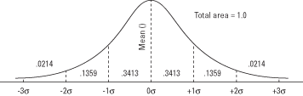
The normal curve and the area under the curve between σ units.

Slide 145
For example, 0.3413 of the curve falls between the mean and one
standard deviation above the mean, which means that about 34
percent of all the values of a normally distributed variable are
between the mean and one standard deviation above it.
It also means that there is a 0.3413 chance that a value drawn at random from the distribution will lie between these two points.
Sections of the curve above and below the mean may be added together to find the probability of obtaining a value within (plus or minus) a given number of standard deviations of the mean.
For example, the amount of curve area between one standard deviation above the mean and one standard deviation below is 0.3413 + 0.3413 = 0.6826, which means that approximately 68.26 percent of the values lie in that range.
Similarly, about 95 percent of the values lie within two standard deviations of the mean, and 99.7 percent of the values lie within three standard deviations.

Slide 146
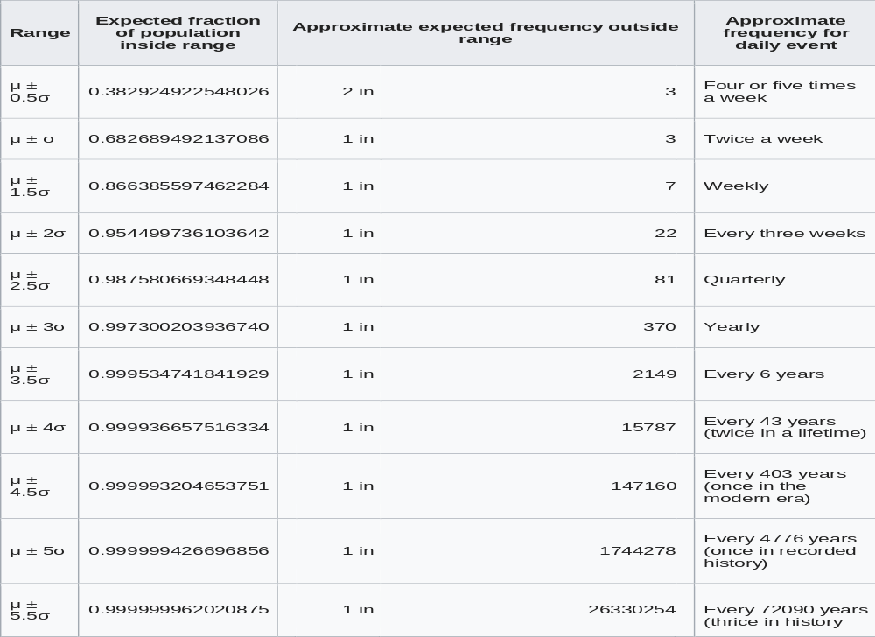

Slide 147
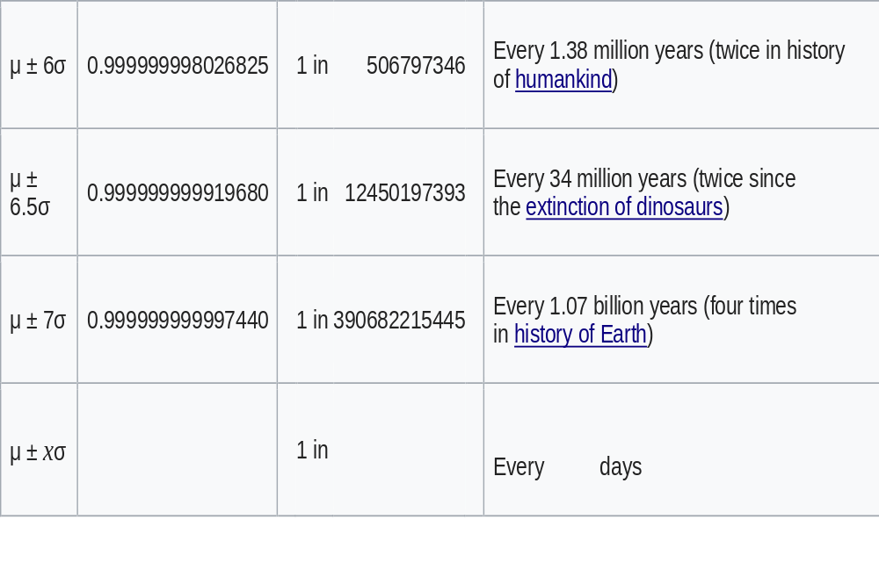

Slide 148

Skewness
The coefficient of skewness is a measure of the symmetry of a distribution
Two formulas for coefficient of skewness
The coefficient of skewness can range from -3 to +3
A value near -3 indicates considerable negative skewness
A value of 1.63 indicates moderate positive skewness
A value of 0 means the distribution is symmetrical
Notes:
Professor Karl Pearson developed the simplest formula for calculating skewness which is based on the difference between the mean and the median.
The textbook also shows the software method of calculating skewness that is based on the cubed deviations from the mean. See Formula 4-3 for more information.

Slide 149
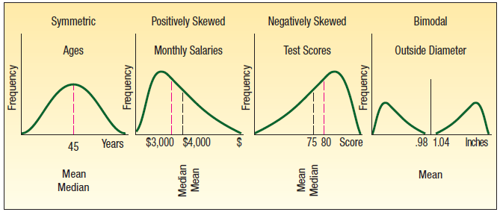
Common Shapes of Data
Notes:
There are four common shapes of data as we see here. Symmetric when mean = median. Positively skewed or skewed to the right when mean > median. Negatively skewed or left skewed when the data values extend further to the left and the mean < median. A bimodal shape has two or more peaks and may indicate two or more populations have been combined.

Slide 150

Skewness Example
Following are the earnings per share for a sample of 15 software companies for the year 2016. The earnings per share are arranged from smallest to largest.
Begin by finding the mean, median, and standard deviation. Find the coefficient of skewness.
What do you conclude about the shape of the distribution?

Slide 151
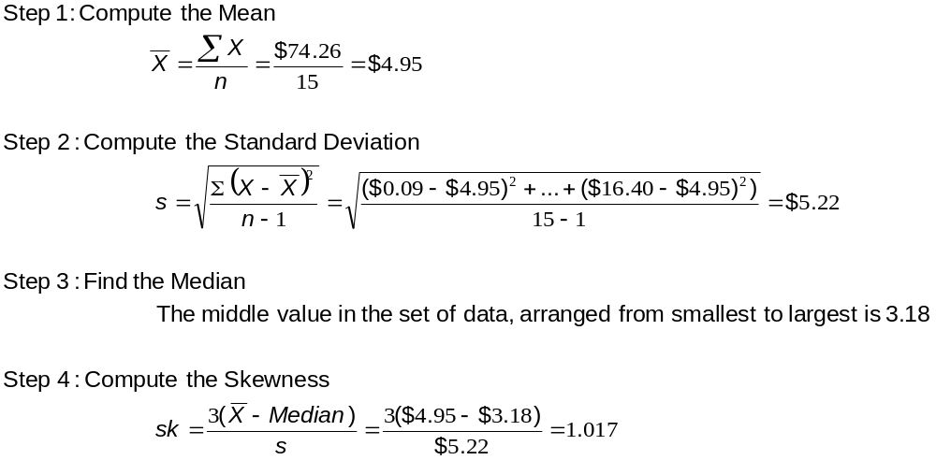
Skewness Example
What do you conclude about the shape of the distribution?
Notes:
The distribution is moderately positively skewed.

Slide 152
Contingency Tables
A contingency table is used to classify nominal scale observations according to two characteristics
It is a cross-tabulation that simultaneously summarizes two variables of interest
Both variables need only be nominal or ordinal
CONTINGENCY TABLE A table used to classify observations according to two identifiable characteristics.
Notes:
If your data is interval or ratio level, it needs to be converted to nominal or ordinal.

Slide 153
The Director of Planning for Devine Dining Inc. wishes to study the relationship between the gender of a guest and whether the guest orders dessert. To investigate the relationship, the manager collected the following information on 200 recent customers.
 | Gender
Dessert Ordered | Male | Female | Total
Yes | 32 | 15 | 47
No | 68 | 85 | 153
Total | 100 | 100 | 200
What is the level of measurement of the two variables?
What is the above table called?
Does the evidence in the table suggest men are more likely to order dessert than women? Explain why.

Slide 154
Answers
A. Both variables are nominal scale.
Contingency Table
Men are about twice as likely to order dessert from the table. 32 percent did while only 15 percent of women did.

Slide 156
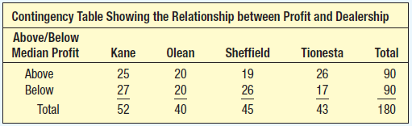
Contingency Table Example
Applewood Auto Group’s profit comparison
90 of the 180 cars sold had a profit above the median and half below. This meets the definition of median.
The percentage of profits above the median are Kane 48%, Olean 50%, Sheffield 42% , and Tionesta 60%.
Notes:
Compute the median profit for all sales last month and then classify profit from sales data as being above or below the median.

Slide 157
Describing the Relationship Between Two Variables
A scatter diagram is a graphical tool to portray the relationship between two variables or bivariate data
Both variables are measured with interval or ratio level scale
If the scatter of points moves from the lower left to the upper right, the variables under consideration are directly or positively related
If the scatter of points moves from the upper left to the lower right, the variables are inversely or negatively related
Notes:
When studying the relationship between two variables the data is referred to as bivariate. When studying just one variable, the data is univariate.

Slide 158
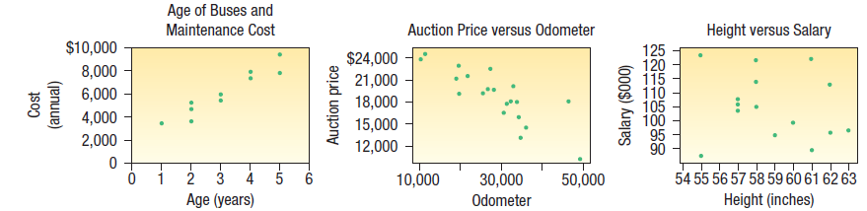
Scatter Diagrams
Notes:
To graph a scatter diagram scale one of the variables, the independent variable, on the horizontal axis and the dependent variable on the vertical axis. In the first graph, there is a positive relationship between the age of the buses and their maintenance cost, as buses increases in age, the maintenance cost increases. The middle graph displays a negative relationship between the odometer reading of a vehicle and its auction price, that is, as the odometer reading rises, the auction price falls. The graph on the right shows there is little relationship between the height of shift supervisors and their annual salary.

Slide 159
A Survey of Probability Concepts
Chapter 5
Notes:
This is the first chapter of inferential statistics. Statistical inference deals with conclusions about a population based on a sample taken from that population. First we learn the different definitions of statistics and then how to calculate probabilities. Later in the chapter, we learn how to calculate the total number of outcomes of an experiment.

Slide 160
Learning Objectives
Define the terms probability, experiment, outcome, sample space and event.
Types of Probabilities:
  Classical
  Empirical
  Subjective
Calculate probabilities using the rules of addition
Calculate probabilities using the rules of multiplication
Compute probabilities using a contingency table
Calculate probabilities using Bayes’ theorem
Determine the number of outcomes using principles of counting

Slide 161
Probability
PROBABILITY A value between zero and one, inclusive, describing the relative possibility (chance or likelihood) an event will occur.
A probability is frequently expressed as a decimal, such as .70, .27, or .50, or a percent such as 70%, 27% or 50%.
It also may be reported as a fraction such as 7/10, 27/100, or 1/2.
It can assume any number from 0 to 1, inclusive.
Expressed as a percentage, the range is between 0% and 100%, inclusive.
Notes:
Probability is a numerical value that describes the chance that something will happen. The closer the probability is to 0, the more improbable. The closer the probability is to 1, the more likely it will happen.

Slide 162
Sometimes, the likelihood of an event is expressed using the term odds.
To explain, someone says the odds are “five to two” that an event will occur. This means that in a total of seven trials (5 + 2), the event will occur five times and not occur two times.
Using odds, we can compute the probability that the event occurs as 5/(5 + 2) or 5/7.
Mathematically:
If the odds in favor of an event are x to y, the probability of the event is x/(x + y).

Slide 163
The closer a probability is to 0, the more improbable it is the event will happen. The closer the probability is to 1, the more likely it will happen.
Certain | 100% | Give or take 0%
The General Area of Possibility
Almost Certain | 93% | Give or take about 6%
Probable | 75% | Give or take about 12%
Chances About Even | 50% | Give or take about 10%
Probably Not | 30% | Give or take about 10%
Almost Certainly Not | 7% | Give or take about 5%
Impossible | 0 | Give or take 0%

Slide 164
EXPERIMENT A process that leads to the occurrence of one and only one of several possible results.
For example, the tossing of a coin is an experiment. You are unsure of the outcome.
In reference to probability, an experiment has two or more possible results, and it is uncertain which will occur.

Slide 165
OUTCOME A particular result of an experiment.
For example, the tossing of a coin is an experiment. You are unsure of the outcome.
When a coin is tossed, one particular outcome is a “head.” The alternative outcome is a “tail.”
How many possible outcomes are there if you toss a coin 3 times?
eight possible outcome
The number of different outcomes when three coins are tossed is 2 × 2 × 2 = 8. All eight possible outcome are HHH, HHT, HTH, HTT, THH, THT, TTH, and TTT.

Slide 166
EVENT A collection of one or more outcomes of an experiment.
How many possible outcomes are there if you toss a coin 3 times?
eight possible outcome
The number of different outcomes when three coins are tossed is 2 × 2 × 2 = 8.
All eight possible outcome are HHH, HHT, HTH, HTT, THH, THT, TTH, and TTT.
Step 2. There are four possible events: 0 heads, 1 head, 2 heads, and 3 heads.

Slide 167

Probability
Notes:
Three key terms used in the study of probability are experiment, outcome, and event. An experiment is the observation of some activity or the act of taking some measurement, like tossing a coin or asking a question. In this example, the experiment is rolling a die. There are six possible outcomes and numerous possible events.

Slide 168
Example: Video Games Inc. recently developed a new video game. Its playability is to be tested by 80 veteran game players.
What is the experiment?
What is one possible outcome?
Suppose 65 of the 80 players testing the new game said they liked it. Is 65 a probability?
The probability that the new game will be a success is computed to be −1.0. Comment.
Specify one possible event.

Slide 169
Answers:
Experiment: Count the number of players who think the game is playable.
Outcome (s): 70 players found the game player. There are several answers
No because probability has to be within 0 and 1. so it is 65/80 = .8125
Probability cannot be negative
Event (s): More than half of players testing it liked it. Several answers are possible.

Slide 170
Approaches to Assigning Probabilities
There are three ways to assign a probability to an event:
Classical
Empirical
Subjective
The classical and empirical methods are objective and are based on information and data.
The subjective method is based on a person’s belief or estimate of an event’s likelihood.

Slide 171


Classical Probability
The classical definition of probability applies when there are n equally likely outcomes to an experiment
MUTUALLY EXCLUSIVE The occurrence of one event means that none of the other events can occur at the same time.
COLLECTIVELY EXHAUSTIVE At least one of the events must occur when an experiment is conducted.
Notes:
There are 3 definitions of probability. The classical approach to probability is often applied to games of chance like playing cards and rolling dice. It can also be applied to lotteries since the total number of outcomes is known before the experiment. If the set of events are collectively exhaustive and mutually exclusive the sum of their probabilities is 1.

Slide 172


Slide 173
The classical approach to probability can also be applied to lotteries. In South Carolina, one of the games of the Education Lottery is “Pick 3.”
A person buys a lottery ticket and selects three numbers between 0 and 9.
Once per week, the three numbers are randomly selected from a machine that tumbles three containers each with balls numbered 0 through 9.
One way to win is to match the numbers and the order of the numbers.
Given that 1,000 possible outcomes exist (000 through 999), the probability of winning with any three-digit number is 0.001, or 1 in 1,000.

Slide 174

Empirical Probability
The empirical definition occurs when the number of times an event happens is divided by the number of outcomes
EMPIRICAL PROBABILITY The probability of an event happening is the fraction of the time similar events happened in the past.
LAW OF LARGE NUMBERS Over a large number of trials, the empirical probability of an event will approach its true probability.
Notes:
Empirical probability is also known as relative frequency. An example of a firm using empirical probability is when life insurance companies use past data to determine the acceptability of an applicant as well as the premium to be charged. In this example, NASA has had 121 successful flights out of a total of 123 flights, therefore, the probability of a successful flight in the future is .98.

Slide 175
To explain the law of large numbers, suppose we toss a fair coin.
The result of each toss is either a head or a tail.
With just one toss of the coin the empirical probability
heads is either zero or one.
If we toss the coin a great number of times, the probability of the outcome of heads will approach .5
The following table reports the results of seven different experiments of flipping a fair coin 1, 10, 50, 100, 500, 1,000, and 10,000 times and then computing the
relative frequency of heads.

Slide 176
Note as we increase the number of trials, the empirical
probability of a head appearing approaches .5, which is
its value based on the classical approach to probability.
What have we demonstrated?
Based on the classical definition of probability, the likelihood of obtaining a head in a single toss of a fair coin is .5
Based on the empirical or relative frequency approach to probability, the probability of the event happening approaches the same value based on the classical definition of probability.

Slide 177
Number of Trials | Number of Heads | Relative Frequency of Heads
1 | 0 | .00
10 | 3 | .30
50 | 26 | .52
100 | 52 | .52
500 | 236 | .472
1,000 | 494 | .494
10,000 | 5,027 | .5027

Slide 178
Subjective Probability
Examples of subjective probability are
Estimating the likelihood the New England Patriots will play in the Super Bowl next year.
Estimating the likelihood you are involved in an automobile accident during the next 12 months.
Estimating the likelihood the U.S. budget deficit will be reduced by half in the next 10 years.
SUBJECTIVE CONCEPT OF PROBABILTIY The likelihood (probability) of a particular event happening that is assigned by an individual based on whatever information is available.
Notes:
If there is little or no data available, probability can be estimated subjectively. A subjective probability is based on whatever information is available; an individual evaluates the available information and then assigns a probability.

Slide 179

Summary of Approaches to Probability
Notes:
Here is a summary of the different approaches to assigning probabilities.

Slide 180
Examples
One card will be randomly selected from a standard 52-card deck. What is the probability the card will be a queen? Which approach to probability did you use to answer this question?
The Center for Child Care reports on 539 children and the marital status of their parents. There are 333 married, 182 divorced, and 24 widowed parents. What is the probability a particular child chosen at random will have a parent who is divorced? Which approach did you use?
What is the probability you will save one million dollars by the time you retire? Which approach to probability did you use to answer this question?

Slide 181
Classical 4/52 or 1/13
Empirical 182/539 = .338
Subjective. Based on your savings habits and income you will assign a probability between .5 and 1

Slide 182
Examples
Some people are in favor of reducing federal taxes to increase consumer spending and others are against it. Two persons are selected and their opinions are recorded. Assuming no one is undecided, list the possible outcomes.
4 outcomes
1. A A
2. A F
3. F A
4. F F

Slide 183
A survey of 34 students at the Wall College of Business showed the following majors:
From the 34 students, suppose you randomly select a student.
What is the probability he or she is a management major?
Which concept of probability did you use to make this estimate?
Accounting | 10
Finance | 5
Economics | 3
Management | 6
Marketing | 10

Slide 184
.176 found by 6/34 Empirical

Slide 185
Class Exercise
In each of the following cases, indicate whether classical, empirical, or subjective probability is used.
A baseball player gets a hit in 30 out of 100 times at bat. The probability is .3 that he gets a hit in his next at bat.
A seven-member committee of students is formed to study environmental issues. What is the likelihood that any one of the seven is randomly chosen as the spokesperson?
You purchase a ticket for the Lotto Canada lottery. Over 5 million tickets were sold. What is the likelihood you will win the $1 million jackpot?
The probability of an earthquake in northern California in the next 10 years above 5.0 on the Richter Scale is .80.

Slide 186
Empirical, Classic, Classic, Empirical

Slide 187
Probability Rules
There are three main rules associated with basic probability: the addition rule, the multiplication rule, and the complement rule. You can think of the complement rule as the 'subtraction rule' if it helps you to remember it.
1.) The Addition Rule: P(A or B) = P(A) + P(B) - P(A and B)
If A and B are mutually exclusive events, or those that cannot occur together, then the third term is 0, and the rule reduces to P(A or B) = P(A) + P(B). For example, you can't flip a coin and have it come up both heads and tails on one toss.

Slide 188
Probability Rules
The Multiplication Rule:
P(A and B) = P(A) * P(B|A) or P(B) * P(A|B)
If A and B are independent events, we can reduce the formula to P(A and B) = P(A) * P(B).
The term independent refers to any event whose outcome is not affected by the outcome of another event. For instance, consider the second of two coin flips, which still has a .50 (50%) probability of landing heads, regardless of what came up on the first flip. What is the probability that, during the two coin flips, you come up with tails on the first flip and heads on the second flip?
Let's perform the calculations: P = P(tails) * P(heads) = (0.5) * (0.5) = 0.25

Slide 189
Probability Rules
The Complement Rule: P(not A) = 1 - P(A) Do you see why the complement rule can also be thought of as the subtraction rule? This rule builds upon the mutually exclusive nature of P(A) and P(not A). These two events can never occur together, but one of them always has to occur. Therefore P(A) + P(not A) = 1. For example, if the weatherman says there is a 0.3 chance of rain tomorrow, what are the chances of no rain?
Let's do the math: P(no rain) = 1 - P(rain) = 1 - 0.3 = 0.7

Slide 190
Rules of Addition for Computing Probabilities
There are two rules of addition:
  Special rule of addition
  General rule of addition.
Notes:
If the events A and B are mutually exclusive, the probability of one or the other event occurring is the sum of their probabilities. This can be extended for more than two events. Here is a Venn diagram illustrating that events A, B, and C do not overlap and are therefore mutually exclusive. See the textbook for more information on Venn diagrams.

Slide 191
Rules of Addition for Computing Probabilities
Special rule of addition:
If two events A and B are mutually exclusive, the special rule of addition states that the probability of one or the other event’s occurring equals the sum of their probabilities.
SPECIAL RULE OF ADDITION P(A or B) = P(A) + P(B)
For three mutually exclusive events designated A, B, and C, the rule is written:
P(A or B or C) = P(A) + P(B) + P(C)
Notes:
If the events A and B are mutually exclusive, the probability of one or the other event occurring is the sum of their probabilities. This can be extended for more than two events. Here is a Venn diagram illustrating that events A, B, and C do not overlap and are therefore mutually exclusive. See the textbook for more information on Venn diagrams.

Slide 192

Rules of Addition Example
A machine fills plastic bags with a mixture of beans, broccoli, and other vegetables. Most of the bags contain the correct weight, but because of the variation in the size of the beans and other vegetables, a package might be underweight or overweight. A check of 4,000 packages filled in the past month revealed:
What is the probability that a particular package will be either underweight or overweight?
P(A or C) = P(A) + P(C) = .025 + .075 = .10
Notes:
Note, the events A, B, and C are mutually exclusive and exhaustive.

Slide 193

English logician J. Venn (1834–1923) developed a diagram to portray graphically the outcome of an experiment.
The mutually exclusive concept and various other rules for combining probabilities can be illustrated using this device.
To construct a Venn diagram, a space is first enclosed representing the total of all possible outcomes. This space is usually in the form of a rectangle. An event is then represented by a circular area that is drawn inside the rectangle proportional to the probability of the event.
The following Venn diagram represents the mutually exclusive concept. There is no overlapping of events, meaning that the events are mutually exclusive. In the following Venn diagram, assume the events A, B, and C are about equally likely.

Slide 194
Complement Rule
The complement rule is used to determine the probability of an event happening by subtracting the probability of an event not happening
You can also use the complement rule
P(A or C) = P(~B) = 1 – P(B) = 1 - .900 = .10
COMPLEMENT RULE P(A) = 1 – P(~A)
Notes:
This rule is useful because sometimes it is easier to calculate the probability of an event happening by determining the probability of it not happening and subtracting the result from 1. The events need to be mutually exclusive and exhaustive.

Slide 195
Narration on the complement rule.
It is used to determine the probability of an event occurring by subtracting the probability of the event not occurring from 1.
This rule is useful because sometimes it is easier to calculate the probability of an event happening by determining the probability of it not happening and subtracting the result from 1.
Notice that the events A and ∼A are mutually exclusive and collectively exhaustive.
Therefore, the probabilities of A and ∼A sum to 1.

Slide 196
Referring to the previous example/solution, the probability a bag of mixed vegetables is underweight is .025 and the probability of an overweight bag is .075.
Use the complement rule to show the probability of a satisfactory bag is .900.
Show the solution using a Venn diagram.

Slide 197
SOLUTION
The probability the bag is unsatisfactory equals the probability the bag is overweight plus the probability it is underweight.
That is, P(A or C) = P(A) + P(C) = .025 + .075 = .100.
The bag is satisfactory if it is not underweight or overweight,
so P(B) = 1 − [P(A) + P(C)] = 1 − [.025 + .075] = 0.900.

Slide 198

The Venn diagram portraying this situation is:

Slide 199
A sample of employees of Worldwide Enterprises is to be surveyed about a new health care plan. The employees are classified as follows:
Classification | Event | Number of Employees
Supervisors | A | 120
Maintenance | B | 50
Production | C | 1,460
Management | D | 302
Secretarial | E | 68

Slide 200
Example
(a) What is the probability that the first person selected is:
(i) either in maintenance or a secretary?
(ii) not in management?
Draw a Venn diagram illustrating your answers to part (a).

Slide 201
Example
(a) What is the probability that the first person selected is:
(i) either in maintenance or a secretary?
50+68/2000 = .059
(ii) not in management?
1 – 302/2000 = .849

Slide 202
B
E

Slide 203
D
~ D

Slide 204

A Venn diagram illustrating the complement rule is shown as:

Slide 205

General Rule of Addition
The general rule of addition is used when the events are not mutually exclusive
GENERAL RULE OF ADDITION P(A or B) = P(A) + P(B) – P(A and B)
JOINT PROBABILITY A probability that measures the likelihood two or more events will happen concurrently.
Notes:
The rules of addition are used to find the probability of two or more events occurring. Here the two events, A and B, overlap and illustrate the joint probability of A and B.

Slide 206

General Rule of Addition Example
A sample of 200 tourists in Florida shows 120 went to Disney, 100 went to Busch Gardens, and 60 visited both.
P(Disney) =120/200 = .60
P(Busch) =100/200 = .50
P(Disney and Busch) = 60/200 = .30
P(Disney or Busch) = P(Disney) + P(Busch) – P (Disney and Busch)
= .60 + .50 - .30 = .80
Notes:
So that we do not double count, subtract the probability of those tourists that went to both attractions.

Slide 207
compare the general and special rules of addition
If we compare the general and special rules of addition, the important difference is determining if the events are mutually exclusive. If the events are mutually exclusive, then the joint probability P(A and B) is 0 and we could use the special rule of addition. Otherwise, we must account for the joint probability and use the general rule of addition.

Slide 208
What is the probability that a card chosen at random from a standard deck of cards will be either a king or a heart?
Card | Probability | Explanation
King | P(A) = 4/52 | 4 kings in a deck of 52 cards
Heart | P(B) = 13/52 | 13 hearts in a deck of 52 cards
King of Hearts | P(A and B) = 1/52 | 1 king of hearts in a deck of 52 cards
P(A or B)=P(A) + P(B) − P(A and B)
4/52 + 13/52 − 1/52
16/52, or .3077

Slide 209


Slide 210
Class Exercise
Routine physical examinations are conducted annually as part of a health service program for General Concrete Inc. employees. It was discovered that 8% of the employees need corrective shoes, 15% need major dental work, and 3% need both corrective shoes and major dental work.
(a) What is the probability that an employee selected at random will need either corrective shoes or major dental work?
(b) Show this situation in the form of a Venn diagram.

Slide 211
Answers
Need for corrective shoes is Event A
Need for major dental work is event B
P(A or B) = P(A) + P(B) – P(A and B)
.08 + .15 - .03 = .2
B .15
A .08
.03

Slide 212
Rules for computing the likelihood that two events both happen, or their joint probability.
Rules of Multiplication to Calculate Probability
For example, 16% of the 2016 tax returns were prepared by H&R Block and 75% of those returns showed a refund.
What is the likelihood a person’s tax form was prepared by H&R Block and the person received a refund?

Slide 213
Special Rule of Multiplication
The rules of multiplication are applied when two or more events occur simultaneously
Notes:
A joint probability is the likelihood that two or more events will happen at the same time. In the AAA example, the events are independent since whether a member made an airline reservation or not has no effect on whether another member made an airline reservation. Therefore the special rule of multiplication can be used.

Slide 214
Special Rule of Multiplication
The special rule of multiplication refers to events that are independent
INDEPENDENCE The occurrence of one event has no effect on the probability of the occurrence of another event.
SPECIAL RULE OF MULTIPLICATON P(A and B) = P(A) P(B)
A survey by the American Automobile Association (AAA) revealed 60% of its members made airline reservations last year. Two members are selected at random. What is the probability both made airline reservations last year?
P(R₁ and R₂) = P(R₁)P(R₂) = (.60)(.60) = .36
Notes:
A joint probability is the likelihood that two or more events will happen at the same time. In the AAA example, the events are independent since whether a member made an airline reservation or not has no effect on whether another member made an airline reservation. Therefore the special rule of multiplication can be used.

Slide 215
Outcomes | Joint Probability
R₁ R₂ | (.60)(.60) = | .36
R₁ ∼R₂ | (.60)(.40) = | .24
∼R₁ R₂ | (.40)(.60) = | .24
∼R₁ ∼R₂ | (.40)(.40) = | .16
Total |  | 1.00

Slide 216
All possible outcomes can be shown as follows. R means a reservation is made, and ∼R means no reservation is made.
With the probabilities and the complement rule, we can compute the joint probability of each outcome. For example, the probability that neither member makes a reservation is .16. Further, the probability of the first or the second member (special addition rule) making a reservation is .48 (.24 + .24). You can also observe that the outcomes are mutually exclusive and collectively exhaustive. Therefore, the probabilities sum to 1.00.

Slide 217
In 2000 George W. Bush won the U.S. presidency by the slimmest of margins. Many election stories resulted, some involving voting irregularities, others raising interesting election questions. In a local Michigan election, there was a tie between two candidates for an elected position. To break the tie, the candidates drew a slip of paper from a box that contained two slips of paper, one marked “Winner” and the other unmarked. To determine which candidate drew first, election officials flipped a coin. The winner of the coin flip also drew the winning slip of paper. But was the coin flip really necessary? No, because the two events are independent. Winning the coin flip did not alter the probability of either candidate drawing the winning slip of paper.

Slide 218
General Rule of Multiplication
If two events are not independent, they are referred to as dependent.
To illustrate dependency, suppose there are 10 cans of soda in a cooler; 7 are regular and 3 are diet.
A can is selected from the cooler.
The probability of selecting a can of diet soda is 3/10, and the probability of selecting a can of regular soda is 7/10.
Then a second can is selected from the cooler, without returning the first. The probability the second is diet depends on whether the first one selected was diet or not. The probability that the second is diet is:
Notes:
When events are not independent, they are dependent. This is called a conditional probability because its value is conditional on what occurred with the first event. In other words, the probability of B is conditional on the occurrence and effect of event A.

Slide 219
2/9, if the first can is diet. (Only two cans of diet soda remain in the cooler.)
3/9, if the first can selected is regular. (All three diet sodas are still in the cooler.)
The fraction 2/9 (or 3/9) is called a conditional probability because its value is conditional on (dependent on) whether a diet or regular soda was the first selection from the cooler.

Slide 220
General Rule of Multiplication
A conditional probability is the likelihood an event will happen, given that another event has already happened
The conditional probability is represented a P(B|A) and is read, the probability of B given A. Or the probability of B is conditional on the occurrence and effect of event A.
CONDITIONAL PROBABILITY The probability of a particular event occurring, given that another event has occurred.
Notes:
When events are not independent, they are dependent. This is called a conditional probability because its value is conditional on what occurred with the first event. In other words, the probability of B is conditional on the occurrence and effect of event A.

Slide 221
General Rule of Multiplication Example
A golfer has 12 golf shirts in his closet. Suppose 9 of these shirts are white and the others are blue. He gets dressed in the dark , so he just grabs a shirt and puts in on. He plays golf two days in a row and does not return the shirts to the closet. What is the probability both shirts are white?
Notes:
So the likelihood of selecting two shirts and finding them both to be white is .55. This can be extended to more than two events.

Slide 222
The event that the first shirt selected is white is W₁. The probability is P(W₁) = 9/12 because 9 of the 12 shirts are white. The event that the second shirt selected is also white is identified as W₂. The conditional probability that the second shirt selected is white, given that the first shirt selected is also white, is P(W₂|W₁) = 8/11. Why is this so? Because after the first shirt is selected, there are only 11 shirts remaining in the closet and 8 of these are white. To determine the probability of 2 white shirts being selected,

Slide 223

General Rule of Multiplication Example
P(W₁ and W₂) = P(W₁)P(W₂|W₁) = ($\frac{9}{12}$)($\frac{8}{11})$= .55
Notes:
So the likelihood of selecting two shirts and finding them both to be white is .55. This can be extended to more than two events.

Slide 224
We can extend the general rule of multiplication to more than two events. For three events A, B, and C, the formula is:
P(A and B and C)=P(A)P(B|A)P(C|A and B)
In the case of the golf shirt example, the probability of selecting three white shirts without replacement is:
P(W1 and W2 and W3)=P(W1) * P(W2|W1) * P(W3|W1 and W2)
=(9/12) * (8/11) * (7/10)
=.38

Slide 225
Class Exercise
The board of directors of Tarbell Industries consists of eight men and four women. A four-member search committee is to be chosen at random to conduct a nationwide search for a new company president.
(a)What is the probability all four members of the search committee will be women?
(b)What is the probability all four members will be men?
(c)Does the sum of the probabilities for the events described in parts (a) and (b) equal 1? Explain.

Slide 226
Class Exercise
(a)What is the probability all four members of the search committee will be women?
4/12 * 3/11 * 2/10 * 1/9 = 24/11880 = .002
(b)What is the probability all four members will be men?
8/12 * 7/12 * 6/12 * 5/12 = 1680/11880 = .1414
(c)Does the sum of the probabilities for the events described in parts (a) and (b) equal 1? Explain.
No because there are several other possibilities like
3W 1M, 2W 2M, 1W 3M

Slide 227
Tree Diagrams
A tree diagram is a visual that is helpful in organizing and calculating probabilities for problems with several stages
Each stage of the problem is represented by a branch of the tree
Label the branches with the probabilities
 |  | Age
 |  | Less than 30 |  |  | 30 up to 60 |  |  | 60 or Older
Movies per Month |  | B₁ |  |  | B₂ |  |  | B₃ |  |  | Total
0 | A₁ |  | 15 |  |  | 50 |  |  | 10 |  | 75
1 or 2 | A₂ |  | 25 |  |  | 100 |  |  | 75 |  | 200
3, 4, or 5 | A₃ |  | 55 |  |  | 60 |  |  | 60 |  | 175
6 or more | A₄ |  | 5 |  |  | 15 |  |  | 30 |  | 50
Total |  |  | 100 |  |  | 225 |  |  | 175 |  | 500
Notes:
Table 5-1 summarizes data from a survey conducted by the National Association of Theater Managers. 500 randomly selected adults were asked their age and the number of times they saw a movie in a theater. The survey results are organized in a contingency table by age and by the number of movies attended per month. See the next slide for an illustration of how to use this data in a tree diagram to calculate probabilities.

Slide 228

Tree Diagram Example
Notes:
This tree diagram summarizes all the probabilities based on the data in table 5-1. This information is useful for making decisions regarding discounts on tickets and concessions.

Slide 229

Bayes’ Theorem
Bayes’ Theorem is a method of revising a probability, given that additional information is obtained
For two mutually exclusive and collectively exhaustive events
PRIOR PROBABILITY The initial probability based on the present level of information.
POSTERIOR PROBABILITY A revised probability based on additional information.
Notes:
A₁ and A₂ are mutually exclusive and exhaustive categories. See the next slide for an example.

Slide 230
Bayes’ Theorem Example
Suppose 5% of the population of Umen have a disease and A₁ represents the part of the population that has the disease and A₂ represents those who do not. Let B denote a test result that shows the disease is present.
P(A₁) = .05 Individual has the disease
P(A₂) = .95 Individual does not have the disease
P(B|A₁) = .90 Test shows the individual has the disease and is correct
P(B|A₂) = .15 Test incorrectly shows the individual has the disease
Randomly select an individual and perform the test. The test results indicate the disease is present. What is the probability the test is correct? Use Bayes’ theorem to solve.
P(A₁|B) = $\frac{P\left(A1\right)P(B|A1)}{P\left(A1\right)P\left(B | A1\right)+P\left(A2\right)P(B|A2) }$ = $\frac{\left(.05\right)(.90)}{\left(.05\right).90)+\left(.95\right)(.15)}$ = $\frac{.0450}{.1875}$ = .24
Notes:
The probability of A₁ and A₂ are prior probabilities since their probabilities are assigned before any empirical data are obtained. P(A₁) = .05 and let A₂ represent the part that does not have the disease. P(A₂) = 1-.05=.95 B denotes the event “test shows the disease is present”. Assume the probability for a positive test result for someone with the disease is .90 and the probability of a positive test result is .15 for the individual who does not have the disease. The probability P(A₁|B) is called a posterior probability since it is a revised probability based on additional information. Using Bayes’ theorem, we find the probability of someone who tests positive and actually has the disease. Therefore the probability that a person has the disease, given that he or she tested positive, is .24.

Slide 231

Multiplication Formula
The multiplication formula states that if there are n ways of doing one thing, and m ways of doing another thing, then there are m*n ways of doing both
An automobile dealer wants to advertise that for $29,999 you can buy a convertible, a 2-door, or a 4-door model with your choice of either wire wheel covers or solid wheel covers. How many different vehicles can the dealer offer?
Total possible = (m)(n)=(3)(2) = 6
Notes:
There are three counting formulas that are useful in determining the number of outcomes in an experiment. This is the multiplication formula that is used to find the total number of arrangements for two or more groups.

Slide 232

The Permutation Formula
Another counting formula used to determine a total number of outcomes
PERMUTATION Any arrangement of r objects selected from a single group of n possible objects.
There are three electronic parts to be assembled, so n=3. Because all three are to be inserted into the plug-in component, r=3.
₃P₃ = $\frac{3!}{\left(3−3\right)!}$ = $\frac{3!}{0!}= \frac{3!}{1}$ = 6
Label the parts A, B, and C ABC BAC CAB ACB BCA CBA
Notes:
Use the permutation formula when the order of the objects is important and to find the number of r objects selected from a group of n objects. Remember by definition, 0! = 1. Excel has a formula that will calculate permutations.

Slide 233


The Combination Formula
Another counting formula useful in determining the total number of outcomes
A combination is an arrangement where the order of the objects selected is not important
The Grand 16 movie theater uses teams of three employees to work the concession stand each evening. There are seven employees available to work. How many different teams can be scheduled?
₇C₃ = $\frac{n!}{r!\left(n−r\right)!}$ = $\frac{7!}{3!\left(7−3\right)!}$ = $\frac{7!}{3!4!}$ = 35
Notes:
The combination formula is used when the order of the objects is not important; it is used to count the number of r object combinations from a set of n objects. Logically, the number of combinations is always less than the number of permutations. In this example, the seven employees taken three at a time would create the possibility of 35 different teams.

Slide 234
Rules of Addition for Computing Probabilities
There are two rules of addition, the special rule of addition and the general rule of addition.
The special rule of addition is used when the events are mutually exclusive
SPECIAL RULE OF ADDITION P(A or B) = P(A) + P(B)
Notes:
If the events A and B are mutually exclusive, the probability of one or the other event occurring is the sum of their probabilities. This can be extended for more than two events. Here is a Venn diagram illustrating that events A, B, and C do not overlap and are therefore mutually exclusive. See the textbook for more information on Venn diagrams.

Slide 235
Contingency Tables
CONTINGENCY TABLE A table used to classify sample observations according to two or more identifiable categories or classes.
One hundred fifty adults were asked their gender and the number of Facebook accounts they used. The following table summarizes the results.
 |  | Gender
Facebook Accounts |  | Men |  |  | Women |  |  | Total
0 |  |  | 20 |  |  | 40 |  |  | 60
1 |  |  | 40 |  |  | 30 |  |  | 70
2 or more |  |  | 10 |  |  | 10 |  |  | 20
 | Total |  | 70 |  |  | 80 |  |  | 150
Notes:
A contingency table is a cross-tabulation that simultaneously summarizes two variables of interest and their relationship. The level of measurement can be nominal.

Slide 236
Discrete Probability Distributions
Chapter 6
Notes:
This chapter begins the study of probability distributions. We first discuss the mean, variance, and standard deviation of a probability distribution. Then we discuss three frequently occurring probability distributions: the binomial, hypergeometric, and Poisson.

Slide 237
Learning Objectives
Identify the characteristics of a probability distribution
Distinguish between discrete and continuous random variables
Compute the mean, variance, and standard deviation of a discrete probability distribution
Explain the assumptions of the binomial distribution and apply it to calculate probabilities
Explain the assumptions of the hypergeometric distribution and apply it to calculate probabilities
Explain the assumptions of the Poisson distribution and apply it to calculate probabilities

Slide 238
What have we done so far
Chapters 2 through 4 were devoted to descriptive statistics.
We describe raw data by organizing the data into a frequency distribution and portraying the distribution in tables, graphs, and charts.
Also, we compute a measure of location—such as the arithmetic mean, median, or mode—to locate a typical value near the center of the distribution.
The range and the standard deviation are used to describe the spread in the data. These chapters focus on describing something that has already happened.

Slide 239
What have we done so far
Starting with Chapter 5, the emphasis changed
We began to examine something that could happen.
We noted that this facet of statistics is called statistical inference. The objective is to make inferences (statements) about a population based on a number of observations, called a sample, selected from the population.
In Chapter 5, we state that a probability is a value between 0 and 1 inclusive, and we examine how probabilities can be combined using rules of addition and multiplication.

Slide 240
Continuing
This chapter begins the study of probability distributions.
A probability distribution is like a relative frequency distribution.
However, instead of describing the past, it is used to provide estimates of the likelihood of future events.

Slide 241
Continuing
Probability distributions can be described by measures of location and dispersion so we show how to compute a distribution’s mean, variance, and standard deviation. We also discuss three frequently occurring discrete probability distributions: the binomial, hypergeometric, and Poisson.

Slide 242
What is a Probability Distribution?
A probability distribution defines or describes the likelihoods for a range of possible future outcomes.
PROBABILITY DISTRIBUTION A listing of all the outcomes of an experiment and the probability associated with each outcome.
CHARACTERISTICS OF A PROBABILITY DISTRIBUTION
The probability of a particular outcome is between 0 and 1 inclusive.
The outcomes are mutually exclusive.
The list of outcomes is exhaustive. So the sum of the probabilities of the outcomes is equal to 1.
Notes:
A probability distribution gives the entire range of values that can occur based on an experiment.

Slide 243

Probability Distribution Example
Suppose we are interested in the number of heads showing face up with 3 tosses of a coin
The possible outcomes are 0 heads, 1 head, 2 heads, and 3 heads
Notes:
Using the counting formula from chapter 5 we note there are 8 possible outcomes when tossing a coin three times since you will observe either a head or a tail, two possibilites, and this toss is repeated 3 times so (2)(2)(2) = 8. Using this data we can construct a probability distribution.

Slide 244

Probability Distribution Table
Probability distribution table and chart for the events of zero, one, two, and three heads
Notes:
Tossing the coin three times results in 8 different outcomes. The events of 0 heads, 1, 2, or 3 heads are mutually exclusive and exhaustive so the sum of the probabilities is 1.000.

Slide 245
Explanation
Refer to the coin-tossing example in Table .
We write the probability of x as P(x).
So the probability of zero heads is P(0 heads) = .125,
and the probability of one head is P(1 head) = .375, and so forth.
The sum of these mutually exclusive probabilities is 1;
that is, from Table .125 + .375 + .375 + .125 = 1.00.

Slide 246
Class Exercise
The possible outcomes of an experiment involving the roll of a six-sided die are a one-spot, a two-spot, a three-spot, a four-spot, a five-spot, and a six-spot.
(a) Develop a probability distribution for the number of possible spots.
(b) Portray the probability distribution graphically.
(c) What is the sum of the probabilities?

Slide 247
Solution
Number of spots Probability
1 1/6
2 1/6
3 1/6
4 1/6
5 1/6
6 1/6
Total 6/6 = 1

Slide 248
Solution Continued

Slide 249
Solution Continued
Sum of probabilities is
1/6 + 1/6 + 1/6 + 1/6 + 1/6 + 1/6 = 6/6 = 1

Slide 250
Random Variables
In any experiment of chance, the outcomes occur randomly. So it is often called a random variable. For example, rolling a single die is an experiment: Any one of six possible outcomes can occur. Some experiments result in outcomes that are measured with quantitative variables (such as dollars, weight, or number of children), and other experimental outcomes are measured with qualitative variables (such as color or religious preference). A few examples will further illustrate what is meant by a random variable.
RANDOM VARIABLE A quantity resulting from an experiment that, by chance, can assume different values.
Notes:
In any experiment of chance, the outcomes occur randomly. So the outcome is called a random variable. Random variables can be measured with quantitative variables or qualitative variables.

Slide 251
Examples of Random Variables
The number of employees absent from the day shift on Monday, the number might be 0, 1, 2, 3, . . . The number absent is the random variable.
The hourly wage of a sample of 50 plumbers in Jacksonville, FL. The hourly wage is the random variable.
The number of defective lightbulbs produced in an hour at the Cleveland Electric Company, Inc.
The grade level (Freshman, Sophomore, Junior, or Senior) of the members of the St. James High School Varsity girls’ basketball team. The grade level is the random variable and notice that it is a qualitative variable.
The number of participants in the 2016 New York City Marathon.
The daily number of drivers charged with driving under the influence of alcohol in Brazoria County, Texas, last month.

Slide 252
Example
In Chapter 5 we defined the terms experiment, outcome, and event. Consider the example we just described regarding the experiment of tossing a fair coin three times. In this case the random variable is the number of heads that appear in the three tosses. There are eight possible outcomes to this experiment. These outcomes are shown in the following diagram.

Slide 253

Example Continued

Slide 254
Example Continued
So, one possible outcome is that a tail appears on each toss: TTT. This single outcome would describe the event of zero heads appearing in three tosses. Another possible outcome is a head followed by two tails: HTT. If we wish to determine the event of exactly one head appearing in the three tosses, we must consider the three possible outcomes: TTH, THT, and HTT. These three outcomes describe the event of exactly one head appearing in three tosses.

Slide 255
Example Continued
In this experiment, the random variable is the number of heads in three tosses. The random variable can have four different values, 0, 1, 2, or 3. The outcomes of the experiment are unknown. But, using probability, we can compute the probability of a single head in three tosses as 3/8 or 0.375. As shown in Chapter 5, the probability of each value of the random variable can be computed to create a probability distribution for the random variable, number of heads in three tosses of a coin.

Slide 256
Two Types of Random Variables
One type of random variable is the discrete random variable
Discrete variables are usually the result of counting
Examples
Tossing a coin three times and counting the number of heads
A bank counting the number of credit cards carried by a group of customers
DISCRETE RANDOM VARIABLE A random variable that can assume only certain clearly separated values.
Notes:
Note: a discrete random variable can assume fractional or decimal values but the values must be separated by having distance between each value.

Slide 257
Discrete Random Variable
For example, the Bank of the Carolinas counts the number of credit cards carried by a group of customers
The number of cards carried is the discrete random variable
Number of Credit Cards | Relative Frequency
0 |  | .03
1 |  | .10
2 |  | .18
3 |  | .21
4 or more |  | .48
Total |  | 1.00
Notes:
The results of this survey were obtained by counting the number of credit cards carried by a group of customers and are summarized in the table using relative frequencies.

Slide 258
Discrete Random Variable
A discrete random variable can, in some cases, assume fractional or decimal values. To be a discrete random variable, these values must be separated—that is, have distance between them. As an example, a department store offers coupons with discounts of 10%, 15%, and 25%. In terms of probability, we could compute the probability that a customer would use a 10% coupon versus a 15% or 25% coupon.

Slide 259

Example

Slide 260
Example Continued
Select three fans randomly at a football game in which Penn State is playing Notre Dame. Identify whether the fan is a Penn State fan (P) or a Notre Dame fan (N). This experiment yields the following sample space:
S = {PPP, PPN, PNP, NPP, NNP, NPN, PNN, NNN}
Let X = the number of Penn State fans selected. The possible values of X are, therefore, either 0, 1, 2, or 3. Now, we could find probabilities of individual events, P(PPP) or P(PPN), for example. Alternatively, we could find P(X = x), the probability that X takes on a particular value x. Let's do that!

Slide 261
Example Continued
Since the game is a home game, let's suppose that 80% of the fans attending the game are Penn State fans, while 20% are Notre Dame fans. That is, P(P) = 0.8 and P(N) = 0.2. Then, by independence:
P(X = 0) = P(NNN) = 0.2 × 0.2 × 0.2 = 0.008
And, by independence and mutual exclusivity of NNP, NPN, and PNN:
P(X = 1) = P(NNP) + P(NPN) + P(PNN) = 3 × 0.2 × 0.2 × 0.8 = 0.096
Likewise, by independence and mutual exclusivity of PPN, PNP, and NPP:
P(X = 2) = P(PPN) + P(PNP) + P(NPP) = 3 × 0.8 × 0.8 × 0.2 = 0.384
Finally, by independence:
P(X = 3) = P(PPP) = 0.8 × 0.8 × 0.8 = 0.512

Slide 262
Example Continued
There are a few things to note here:
The results make sense! Given that 80% of the fans in the stands are Penn State fans, it shouldn't seem surprising that we would be most likely to select 2 or 3 Penn State fans.
The probabilities behave well in that (1) the probabilities are all greater than 0, that is, P(X = x) > 0 and (2) the probability of the sample space is 1, that is, P(S) = P(X = 0) + P(X = 1) + P(X = 2) + P(X = 3) = 1.
Because the values that it takes on are random, the variable X has a special name. It is called a random variable!

Slide 263
Mean of a Probability Distribution
The mean is a typical value used to represent the central location of the data
The mean is also referred to as the expected value
where P(x) is the probability of a particular value x. In other words, multiply each x value by its probability of occurrence, and then add these products.
Notes:
The mean of a probability distribution is the long run average of the random variable. P(x) represents the probability of a particular value of x. To calculate the mean, multiply each value of x by its probability of occurrence and then add these products.

Slide 264
Example
John Ragsdale sells new cars for Pelican Ford. John usually sells the largest number of cars on Saturday. He has developed the following probability distribution for the number of cars he expects to sell on a particular Saturday.

Slide 265
Number of Cars Sold, x | Probability, P(x)
0 | .1
1 | .2
2 | .3
3 | .3
4 | .1
 | 1.0
What type of distribution is this?
On a typical Saturday, how many cars does John expect to sell?
What is the variance of the distribution?

Slide 266
Example Continued
This is a discrete probability distribution for the random variable called “number of cars sold.” Note that John expects to sell only within a certain range of cars; he does not expect to sell 5 cars or 50 cars. Further, he cannot sell half a car. He can sell only 0, 1, 2, 3, or 4 cars. Also, the outcomes are mutually exclusive—he cannot sell a total of both 3 and 4 cars on the same Saturday. The sum of the possible outcomes total 1. Hence, these circumstance qualify as a probability distribution.

Slide 267
Example Continued
The mean number of cars sold is computed by weighting the number of cars sold by the probability of selling that number
μ=Σ[xP(x)]
= 0(.1)+1(.2)+2(.3)+3(.3)+4(.1)
= 2.1

Slide 268
Example Continued
These calculations are summarized in the following table
Number of Cars Sold, x | Probability, P(x) | x · P(x)
0 | .1 | 0.0
1 | .2 | 0.2
2 | .3 | 0.6
3 | .3 | 0.9
4 | .1 | 0.4
 | 1.0 | μ = 2.1

Slide 269
Example Continued
How do we interpret a mean of 2.1? This value indicates that, over a large number of Saturdays, John Ragsdale expects to sell a mean of 2.1 cars a day. Of course, it is not possible for him to sell exactly 2.1 cars on any particular Saturday. However, the expected value can be used to predict the arithmetic mean number of cars sold on Saturdays in the long run. For example, if John works 50 Saturdays during a year, he can expect to sell (50) (2.1) or 105 cars just on Saturdays. Thus, the mean is sometimes called the expected value.

Slide 270
Variance of a Probability Distribution
The amount of spread (or variation) in the data is described by the variance
The standard deviation of the probability distribution is the positive square root of the variance
Notes:
The mean of a probability distribution is the long run average of the random variable. P(x) represents the probability of a particular value of x. To calculate the mean, multiply each value of x by its probability of occurrence and then add these products.

Slide 271
Variance of a Probability Distribution
The computational steps are:
Subtract the mean from each value of the random variable, and square this difference.
Multiply each squared difference by its probability.
Sum the resulting products to arrive at the variance.
The standard deviation, σ, is found by taking the
positive square root of σ²;

Slide 272


Probability Distribution Mean Example
John Ragsdale sells new cars for Pelican Ford. John usually sells the most cars on Saturday. He has developed a probability distribution for the number of cars he expects to sell on Saturday.
What type of distribution is this?
How many cars does John expect to sell on a typical Saturday?
What is the variance?
Notes:
This is a discrete probability distribution. We find John can expect to sell 2.1 cars on a typical Saturday. In other words, over the long run, say 50 Saturdays in a year, he can expect to sell (50)(2.1) = 105 cars. The variance is calculated on the next slide.

Slide 273

Probability Distribution Variance Example
The computational steps for variance
Subtract the mean from each value of x and square
Multiply each squared difference by its probability
Sum the resulting products to arrive at the variance
Notes:
Take the (positive) square root of the variance to get the standard deviation. The mean is 2.1, the variance is 1.290, and the standard deviation is 1.136 cars.

Slide 274
Probability Distribution Variance Example
√=1.290−−−−√=1.136 carsσ2=1.290=1.136 cars.
Recall that the standard deviation, σ, is the positive square root of the variance. In this example,
σ2−−√=1.290−−−−√=1.136 cars
How do we apply a standard deviation of 1.136 cars? If salesperson Rita Kirsch also sold a mean of 2.1 cars on Saturdays, and the standard deviation in her sales was 1.91 cars, we would conclude that there is more variability in the Saturday sales of Ms. Kirsch than in those of Mr. Ragsdale (because 1.91 > 1.136)

Slide 275
Example
The Pizza Palace offers three sizes of cola. The smallest size sells for $1.99, the medium for $2.49, and the large for $2.89. Thirty percent of the drinks sold are small, 50% are medium, and 20% are large. Create a probability distribution for the random variable price and answer the following questions.
(a)Is this a discrete probability distribution? Indicate why or why not.
(b)Compute the mean amount charged for a cola.
(c)What is the variance in the amount charged for a cola? The standard deviation?

Slide 276
Example Continued
Discrete as values are separated clearly 1.99 2.49 2.89
x P(x) xP(x)
1.99 .30 0.597
2.49 .50 1.245
2.89 .20 0.578
Sum is 2.42

Slide 277
Example Continued
Discrete as values are separated clearly 1.99 2.49 2.89
x P(x) xP(x) (x-ϕ) (x-ϕ)²P(x)
1.99 .30 0.597 -0.43 0.05547
2.49 .50 1.245 0.07 0.00245
2.89 .20 0.578 0.47 0.04418
Sum is 2.42
Variance is 0.10210
SD is 31.95 Cents

Slide 278
A Bernoulli trial
In statistical terms, A Bernoulli trial is each repetition of an experiment involving only 2 outcomes.
The usual notation is
p = probability of success, q = probability of failure = 1 - p.
And p + q = 1.
We are often interested in the result of independent, repeated bernoulli trials, i.e. the number of successes in repeated trials.

Slide 279
Binomial probability distribution
The binomial probability distribution is a widely occurring discrete probability distribution. To describe experimental outcomes with a binomial distribution, there are four requirements.

Slide 280
Binomial probability distribution
A probability distribution based on a discrete random variable. Its major characteristics are:
1. Each outcome can be classified into one of two mutually exclusive categories.
2. The distribution is the result of counting the number of successes.
3. Each trial is independent, meaning that the answer to trial 1 (correct or wrong) in no way affects the answer to trial 2.
4. The probability of a success stays the same from trial to trial.

Slide 281
Binomial Probability Experiment
Use the number of trials, n, and the probability of a success, $\text{π},$ to compute binomial probability
Note: Do not confuse the symbol $\text{π},$ with the mathematical constant 3.1416
BINOMIAL PROBABILITY EXPERIMENT
An outcome on each trial of an experiment is classified into one of two mutually exclusive categories — a success or a failure.
The random variable is the number of successes in a fixed number of trials.
The probability of success is the same for each trial.
The trials are independent, meaning that the outcome of one trial does not affect the outcome of any other trial.
Notes:
The Greek letter $\text{π}$, (pi) is used to denote a binomial population parameter. The formula to compute binomial probability is found on the next slide.

Slide 282

How is a Binomial Probability Computed?
There are five flights daily from Pittsburgh via US Airways into the Bradford Regional Airport in Bradford, Pennsylvania. Suppose the probability that any flight arrives late is .20.
What is the probability that none of the flights are late today?
P(x) = _{n}C_{r}($π)r\left(1−π\right)n−r$
P(0) = ₅C₀($.20)0\left(1−.20\right)5−0$
= (1)(1)(.3277) = .3277
What is the probability that exactly one of the flights is late today?
P(x) = _{n}C_{r}($π)r\left(1−π\right)n−r$
P(1) = ₅C₁($.20)1\left(1−.20\right)5−1$
= (1)(1)(.4096) = .4096
Notes:
C represents a combination; you may recall we calculated combinations in chapter 5. In this example, just insert the value for x that you wish to find, the value 5 for n and .20 for $π$, and solve. With an n = 5, we can find the probabilities for 6 different x outcomes: 0, 1, 2, 3, 4, and 5 late flights. See the table on the next page.

Slide 283

Binomial Probability Distribution
There are five flights daily from Pittsburgh via US Airways into the Bradford Regional Airport in Bradford, Pennsylvania. Suppose the probability that any flight arrives late is .20. What is the probability that none of the flights are late today? What is the probability that exactly 1 of the flights is late today?
Notes:
Use formula 6-3 to complete the table by finding the P(x) for the number of successes from 0 to 5. Then multiply each value of x by its probability and sum the products. The result will be the mean. Next, find the differences of each value of x and the mean and then square these differences. Multiply this squared value by the respective probability and sum the products, the result is the variance.

Slide 284

Shortcut Formulas
Using the preceding example of flights into Bradford Airport; n=5 and $π=.20 and the shortcut formulas$
                $$μ=n π$$
                $$μ=\left(5\right)\left(.20\right)=1.00$$
                $$σ2=nπ\left(1−π\right)$$
                $σ2=\left(5\right)\left(.20\right)\left(1−.20\right)=$.80
Notes:
Here is a shortcut method of finding the mean and variance of a binomial distribution. Verify these results with the table on the preceding slide.

Slide 285
Cumulative Binomial Probability Distributions
A study by the Illinois Department of Transportation concluded that 76.2% of front seat occupants wore seat belts. That is, both occupants of the front seat were using their seat belts. Suppose we decide to compare that information with current usage. We select a sample of 12 vehicles.
What is the probability that the front seat occupants in exactly 7 of the 12 vehicles are wearing seat belts?
P(x) = _{n}C_{r}($π)r\left(1−π\right)n−r$
P(x=7) = ₁₂C₇($.762)7\left(1−.762\right)12−7$
= 792(.149171)(.000764) = .0902
What is the probability that at least 7 of the 12 front seat occupants are wearing seat belts?
P(x≥7) = P(x=7) + P(x=8) + P(x=9) + P(x=10) + P(x=11) + P(x=12)
=.0902 + .1805 + .2569 + .2467 + .1436 + .0383
=.9562
Notes:
We conclude the likelihood that the occupants of exactly 7 out of 12 sampled vehicles will be wearing their seat belts is about 9%. And the probability of selecting 12 cars and finding that the occupants of 7 or more vehicles were wearing seat belts is .9562. The Excel commands for these calculations are found in Appendix C.

Slide 286
Hypergeometric Distribution
When sampling from relatively small populations without replacement, use the hypergeometric distribution
HYPERGEOMETRIC PROBABILITY EXPERIMENT
An outcome on each trial of an experiment is classified into one of two mutually exclusive categories — a success or a failure.
The random variable is the number of successes in a fixed number of trials.
The trials are not independent.
We assume that we sample from a finite population without replacement and n/N > 0.05. So, the probability of a success changes for each trial.
Notes:
Here is a list of the characteristics of the Hypergeometric Distribution.

Slide 287


Hypergeometric Formula
PlayTime Toys Inc. employs 50 people in the Assembly Dept. Forty of the employees belong to a union and 10 do not. Five employees are selected at random to form a committee. What is the probability that four of the five belong to a union.
$$P\left(4\right)= \frac{(40C4)(50\text{−}40C5\text{−}4)}{50C5}$$
= $\frac{(91,390)(10)}{2,118,760}$ = .431
Notes:
Insert the following values in the formula and solve. N=50, S=40, x is 4, n is 5. Thus, the probability of selecting 5 assembly workers at random from the 50 workers and finding 4 of the 5 are union members is .431.

Slide 288

Poisson Distribution
POISSON PROBABILITY EXPERIMENT
The random variable is the number of times some event occurs during a defined interval.
The probability of the event is proportional to the size of the interval.
The intervals do not overlap and are independent.
Notes:
The variance of the Poisson Distribution is equal to its mean.

Slide 289

Binomial Probability Tables
Tables are already constructed for use as well
In the Southwest, 5% of all cell phone calls are dropped. What is the probability that out of six randomly selected calls, none was dropped? Exactly one? Exactly two? Exactly three? Exactly four? Exactly five? Exactly six out of six? See the table below for the answers.
Notes:
In this example, the conditions for a binomial distribution are met. You can build a binomial probability distribution using Formula 6-3 for any value of n and $π$. However, the calculations take time. For convenience, tables like the one here are provided in Appendix B.1 for various values of n and $π$.
Excel can be used to find binomials as well.

Slide 292
Binomial Distribution
Example
A young family has two children, both boys. The probability of the third birth being a boy is still .50. The gender of the third child is independent of the gender of the other two.
Notes:
The binomial distribution is a widely occurring discrete probability distribution.

Slide 294
Hypergeometric Probabilities
Union Members | Probability
0 |  | .000
1 |  | .004
2 |  | .044
3 |  | .210
4 |  | .431
5 |  | .311
 |  | 1.000
Notes:
Table 6-4 Hypergeometric Probabilities (n=5, N=50, and S=40) for the Number of Union members on the Committee. This table shows the hypergeometric probabilities of finding 0, 1, 2, 3, 4, and 5 union members on the committee. Excel can be used to create a hypergeometric distribution too; the steps to do so can be found in Appendix C.

Slide 295
Poisson Probability Distribution
This describes the number of times some event occurs during a specified interval
The interval can be time, distance, area, or volume
Two assumptions
  The probability is proportional to the length of the interval
  The intervals are independent
The Poisson has many applications like describing
  The distribution of errors in data entry
  The number of accidents on I-75 during a three-month period
Notes:
The Poisson is a discrete probability distribution since it is formed by counting. It is often referred to as the law of improbable events because the probability of an event happening is small.

Slide 296
Poisson Distribution Example
Budget Airlines is a seasonal airline that operates flights from Myrtle Beach, South Carolina, to various cities in the northeast. Recently Budget has been concerned about the number of lost bags. Ann Poston from the Analytics Department was asked to study the issue. She randomly selected a sample of 500 flights and found that a total of twenty bags were lost on the sampled flights.
The mean number of bags lost, $\text{μ}\text{,}$ is found by 20/500 = .04
The probability that no bags are lost is found using formula 6-7.
$P\left(0\right)=\frac{μxe−μ}{x!}=$ $\frac{.040e−0.04}{0!}$ = .9608
Then calculate the probability that one or more bags is lost.
P(x≥1) =1-$P\left(0\right)=1− \frac{μxe−μ}{x!}=$ 1 - $\frac{.040e−0.04}{0!}$ = 1- .9608 = .0392
Notes:
Begin by confirming the situation fits the Poisson Distribution characteristics. Then calculate the mean using the sample information. Poisson probabilities can be found using Excel too; the commands can be found in Appendix C.

Slide 297

Poisson Probability Distribution Tables
NewYork-LA Trucking company finds the mean number of breakdowns on the New York to Los Angeles route is 0.30. From the table, we can locate the probability of no breakdowns on a particular run. Find the column 0.3, then read down that column to the row labeled 0; the value is .7408. The probability of 1 breakdown is .2222
Notes:
Table 6-7 Poisson Table for Various Values of $\text{μ}\text{. }$The Poisson distribution tables can be found in Appendix B.2

Slide 298
Continuous Random Variables
Continuous random variables can assume an infinite number of values within a given range
Continuous variables are usually the result of measuring
Examples
The time between flights between Atlanta and LA are 4.67 hours, 5.13 hours, and so on
The annual snowfall in Minneapolis, MN measured in inches
Notes:
Continuous random variables are measured with interval or ratio scale and the likelihood of a continuous random variable can be summarized with a probability distribution. This will be covered in the next chapter.

Slide 299
Example
As with discrete random variables, the likelihood of a continuous random variable can be summarized with a probability distribution. For example, with a probability distribution for the flight time between Atlanta and Los Angeles, we could say that there is a probability of 0.90 that the flight will be less than 4.5 hours. This also implies that there is a probability of 0.10 that the flight will be more than 4.5 hours. With a probability of snowfall in Minneapolis, we could say that there is probability of 0.25 that the annual snowfall will exceed 48 inches. This also implies that there is a probability of 0.75 that annual snowfall will be less than 48 inches. Notice that these examples refer to a continuous range of values.

Slide 300
Suppose, for example, we want to find the probability of getting 4 heads in 10 tosses. In this case, we’ll call getting a heads a “success.” Also, in this case, n = 10, the number of successes is r = 4, and the number of failures (tails) is n – r = 10 – 4 = 6. One way this can occur is if the first 4 tosses are heads and the last 6 are tails, i.e.
The Binomial Distribution - Page 1
S S S S F F F F F F
The likelihood of this occurring is
P(S) * P(S) * P(S) * P(S) * P(F) * P(F) * P(F) * P(F) * P(F) * P(F)
More generally, if p = probability of success and q = 1 – p = probability of failure, the probability of a specific sequence of outcomes where there are r successes and n-r failures is rnq −rp So, in this particular case, p = q = .5, r = 4, n-r = 6, so the probability of 4 straight heads followed by 6 straight tails is .54.56 = 0.0009765625 (or 1 out of 1024).

Slide 301
A binomial distribution gives us the probabilities associated with independent, repeated Bernoulli trials. In a binomial distribution the probabilities of interest are those of receiving a certain number of successes, r, in n independent trials each having only two possible outcomes and the same probability, p, of success.
So, for example, using a binomial distribution, we can determine the probability of getting 4 heads in 10 coin tosses.
How does the binomial distribution do this? Basically, a two part process is involved. First, we have to determine the probability of one possible way the event can occur, and then determine the number of different ways the event can occur. That is,
P(Event) = (Number of ways event can occur) * P(One occurrence).

Slide 302
Of course, this is just one of many ways that you can get 4 heads; further, because the repeated trials are all independent and identically distributed, each way of getting 4 heads is equally likely, e.g. the sequence S S S S F F F F F F is just as likely as the sequence S F S F F S F F S F. So, we also need to know how many different combinations produce 4 heads.
Well, we could just write them all out…but life will be much simpler if we take advantage of two counting rules:
1. The number of different ways that N distinct things may be arranged in order is N! = (1)(2)(3)...(N-1)(N), (where 0! = 1).
An arrangement in order is called a permutation, so that the total number of permutations of N objects is N!. The symbol N! is called N factorial.
EXAMPLE. Rank candidates A, B, and C in order. The possible permutations are: ABC ACB BAC BCA CBA CAB. Hence, there are 6 possible orderings. Note that 3! = (1)(2)(3) = 6.

Slide 304
Continuous Probability Distributions
Chapter 7
Notes:
This chapter continues the study of probability distributions by examining continuous probability distributions. We learn about three continuous probability distributions: the uniform probability distribution, the normal probability distribution, and the exponential probability distribution.

Slide 305
Learning Objectives
Describe the uniform probability distribution and use it to calculate probabilities
Describe the characteristics of a normal probability distribution and use it to calculate probabilities
Describe the exponential probability distribution and use it to calculate probabilities.
Approximate the binomial probability distribution using the standard normal probability distribution to calculate probabilities

Slide 306
Differences in the way probabilities are assigned
In a probability distribution for a discrete random variable, each possible outcome of the random variable is assigned its own probability.
For continuous random variable, there are infinitely number of outcomes and each has no probability.
Outcomes of a continuous random variable do not have probability assigned to any one point because there are simple too many points.
Thus, for continuous random variables, probability is ONLY assigned to intervals.

Slide 307
The Uniform Distribution
The uniform distribution is a continuous probability distribution and is concerned with events that are equally likely to occur. When working out problems that have a uniform distribution, be careful to note if the data is inclusive or exclusive.

Slide 308

Uniform Distribution
The uniform distribution characteristics
  It is rectangular in shape
  The mean and the median are equal
  It is completely described by its minimum value a and its maximum value b
Notes:
The uniform distribution is a continuous distribution. If you know the minimum and maximum values, designated a and b, you can calculate the mean, the standard deviation, and any probability you wish to find.

Slide 309

Uniform Distribution Formulas
The mean and standard deviation of a uniform distribution are computed as follows
The following equation describes the region from a to b
Notes:
These are the formulas to use when working with uniform distributions.

Slide 310
Example
USC Upstate provides bus service to students from the George to main campus. A bus arrives at the George every 30 minutes between 6 a.m. and 11 p.m. during weekdays. Students arrive at the bus stop at random times. The time that a student waits is uniformly distributed from 0 to 30 minutes.
Draw a graph of this distribution.
Show that the area of this uniform distribution is 1.00.
How long will a student “typically” have to wait for a bus? In other words, what is the mean waiting time? What is the standard deviation of the waiting times?
What is the probability a student will wait more than 25 minutes?
What is the probability a student will wait between 10 and 20 minutes?

Slide 311

Uniform Distribution Example
USC Upstate provides bus service to students from the George to main campus. A bus arrives at the George every 30 minutes between 6 a.m. and 11 p.m. during weekdays. Students arrive at the bus stop at random times. The time that a student waits is uniformly distributed from 0 to 30 minutes.
Notes:
Here is a graph of the distribution of student wait times for a bus. The minimum wait time is 0 minutes and the maximum wait time is 30 minutes, so the range of the distribution is 30 minutes. The height is 1/(b-a)= 1/30 = .0333

Slide 312

Uniform Distribution Example
The area of the uniform distribution is found by multiplying height *base
Area = $\frac{\text{1}}{\text{30−0}}$ (30-0) = 1.00
The mean is $\text{μ}\text{=}\frac{\text{a}\text{+}\text{b}}{\text{2}}$ = $\frac{\text{0+30}}{\text{2}}$ = 15
The standard deviation is $\text{σ}\text{= }\sqrt{\frac{\left(\text{b}\text{−}\text{a}\right)\text{2}}{\text{12}}}$ = $\sqrt{\frac{\left(\text{30−0}\right)\text{2}}{\text{12}}}$ = 8.66
Notes:
With continuous distributions, area represents probability and the uniform distribution’s rectangular shape allows us to use the area formula for a rectangle. Here, with a minimum wait time of 0 minutes and a maximum wait time of 30 minutes, the entire area of the distribution is 1.00. The mean is 15 so the typical wait time for bus service is 15 minutes. The standard deviation is 8.66; this measures the variation in student wait times.

Slide 313


Uniform Distribution Example
To find the probability that a student will wait more than 25 minutes, find the area between 25 and 30 minutes.
P(25 < wait time < 30) = (height)(base) = $\frac{1}{(30−0)}$ (5) = .1667
Notes:
To find the probability of various wait times, use formula 7-3. In this example, the probability a student will wait more than 25 minutes is .1667.

Slide 314


Uniform Distribution Example
To find the probability that a student will wait between 10 and 20 minutes, find the area between 10 and 20 minutes.
P(10 < wait time < 20) = (height)(base) = $\frac{1}{(30−0)}$ (10) = .3333
Notes:
Using formula 7-3, we find the probability that a student waits between 10 and 20 minutes is .3333.

Slide 315
Example 2
Microwave ovens only last so long. The life-time of a microwave oven follows a uniform distribution between 8 and 14 years.
(a) Draw this uniform distribution. What are the height and base values?
(b)Show the total area under the curve is 1.00.
(c)Calculate the mean and the standard deviation of this distribution.
(d)What is the probability a particular microwave oven lasts between 10 and 14 years?
(e)What is the probability a microwave oven will last less than 9 years?

Slide 316
Solutions to Example 2
Microwave ovens only last so long. The life-time of a microwave oven follows a uniform distribution between 8 and 14 years.
(a) Draw this uniform distribution. What are the height and base values? 8 14 .167 (1/14-8)
(b)Show the total area under the curve is 1.00. 1/14-8 * 6 (Total area) = 1
(c) Calculate the mean and the standard deviation of this distribution. 8+14/2 = 11
(d)14-8 /12 square root = 3 square root = 1.73
What is the probability a particular microwave oven lasts between 10 and 14 years? 1/14-8 * 14-10 = .667
(e)What is the probability a microwave oven will last less than 9 years? 1/14-8 * (9-8) = .167

Slide 317
Example 3
Example
Let’s say the amount of gasoline sold every day at a service station is uniformly distributed. The minimum sold is 1000 gallons and maximum sold is 3000 gallons.
We can calculate the probability that the service station will sell at least 2,000 gallons using the uniform distribution properties.

Slide 318

Solutions to Example 3
P(X ≥ 2,000) = (3,000 – 2,000) x (1/2000) = .50

Slide 319
Permutation and Combination
In mathematics, you might have heard the notions of permutation and combination end number of times, but have you ever imagined that these two are different concepts? The fundamental difference between permutation and combination is the order of objects, in permutation the order of objects is very important, i.e. the arrangement must be in the stipulated order of the number of objects, taken only some or all at a time.
As against this, in the case of a combination, the order does not matter at all. Not only in mathematics but in practical life too, we go through with these two concepts regularly. Although, we never notice it.

Slide 320
Permutations
Permutation
A permutation is an arrangement in a particular order of a group of items.
There are to be no repetitions of items within a permutation.)

Slide 321
Listing Permutations
How many different permutations of the letters a, b, c are possible?
Solution: There are six different permutations:
abc, acb, bac, bca, cab, cba.

Slide 322
Listing Permutations
How many different two-letter permutations of the letters a, b, c, d are possible?
Solution: There are twelve different permutations:
ab, ac, ad, ba, ca, da, bc, bd, cb, db, cd, dc.

Slide 323

Permutation Formula
The number of ways to arrange in order n distinct objects, taking them r at a time, is:

Slide 324

Another notation for permutations:

Slide 325

Find P_{7, 3}

Slide 326
Applying the Permutation Formula
P_{3, 3} = _______ P_{4, 2} = _______
P_{6, 2 = __________} P_{8, 3} = _______
P_{15, 2 = _______}
6
12
30
336
210

Slide 327

Application of Permutations
A teacher has chosen eight possible questions for an upcoming quiz. In how many different ways can five of these questions be chosen and arranged in order from #1 to #5?
Solution: P_{8,5} =
= 8• 7 • 6 • 5 • 4 = 6720

Slide 328
Combinations
A combination is a grouping
in no particular order
of items.

Slide 329

Combination Formula
The number of combinations of n objects taken r at a time is:

Slide 330

Other notations for combinations:

Slide 331

Find C_{9, 3}

Slide 332
Key Differences Between Permutation and Combination
The differences between permutation and combination are drawn clearly on the following grounds:
The term permutation refers to several ways of arranging a set of objects in a sequential order. Combination implies several ways of choosing items from a large pool of objects, such that their order is irrelevant.
The primary distinguishing point between these two mathematical concepts is order, placement, and position, i.e. in permutation characteristics mentioned above does matter, which does not matter in the case of the combination.
Permutation denotes several ways to arrange things, people, digits, alphabets, colors, etc. On the other hand, combination indicates different ways of selecting menu items, food, clothes, subjects, etc.

Slide 333
Key Differences Between Permutation and Combination
The permutation is nothing but an ordered combination while Combination implies unordered sets or pairing of values within specific criteria.
Many permutations can be derived from a single combination. Conversely, only a single combination can be obtained from a single permutation.
Permutation answers How many different arrangements can be created from a given set of objects? As opposed to the combination which explains How many different groups can be picked from a larger group of objects?

Slide 334
Normal Probability Distribution
The normal distribution originally called the Gaussian distribution was named after Karl Gauss who published a work in 1833 describing the mathematical definition of the distribution.
  Normal distributions are all bell shaped but the bells come in various shapes and sizes.
  Since all normal distributions are symmetric, the mean, mode and median are all equal.
  Range can occur from minus infinity to positive infinity, values that are a great distance from the mean rarely occur. (Six Sigma)
  It is completely described by its mean and standard deviation.
  The total area under any normal curve equals one.
Notes:
The normal probability distribution has a complex formula (see Formula 7-4) to find probabilities but we will not need to use it. Instead, we use the table given in Appendix B.3. You can also use Excel to find these probabilities.

Slide 335
Normal Probability Distribution
The normal probability distribution is a continuous distribution with the following characteristics
  It is bell-shaped and has a single peak at the center of the distribution
  The distribution is symmetric
  It is asymptotic, meaning the curve approaches but never touches the X-axis. (Tails)
  It is completely described by its mean and standard deviation
Notes:
The normal probability distribution has a complex formula (see Formula 7-4) to find probabilities but we will not need to use it. Instead, we use the table given in Appendix B.3. You can also use Excel to find these probabilities.

Slide 336
Normal Probability Distribution
There is a family of normal probability distributions
  Another normal probability distribution is created when either the mean or the standard deviation changes
Notes:
The normal probability distribution has a complex formula (see Formula 7-4) to find probabilities but we will not need to use it. Instead, we use the table given in Appendix B.3. You can also use Excel to find these probabilities.

Slide 337
Common Properties for All Forms of the Normal Distribution
Despite the different shapes, all forms of the normal distribution have the following characteristic properties.
They’re all symmetric. The normal distribution cannot model skewed distributions.
The mean, median, and mode are all equal.
Half of the population is less than the mean and half is greater than the mean.
The Empirical Rule allows you to determine the proportion of values that fall within certain distances from the mean.

Slide 338
The Empirical Rule for the Normal Distribution
When you have normally distributed data, the standard deviation becomes particularly valuable. You can use it to determine the proportion of the values that fall within a specified number of standard deviations from the mean. For example, in a normal distribution, 68% of the observations fall within +/- 1 standard deviation from the mean. This property is part of the Empirical Rule, which describes the percentage of the data that fall within specific numbers of standard deviations from the mean for bell-shaped curves.

Slide 339
Mean +/- standard deviations | Percentage of data contained
1 | 68%
2 | 95%
3 | 99.7%

Slide 340

Bell Curve with Six Sigma

Slide 341


Slide 342
Let’s look at a pizza delivery example. Assume that a pizza restaurant has a mean delivery time of 30 minutes and a standard deviation of 5 minutes. Using the Empirical Rule, we can determine that 68% of the delivery times are between 25-35 minutes (30 +/- 5), 95% are between 20-40 minutes (30 +/- 2*5), and 99.7% are between 15-45 minutes (30 +/-3*5). The chart below illustrates this property graphically.

Slide 343


Slide 344

The Normal Curve
Notes:
Here is a graphical display of the characteristics of the normal distribution. The location of a normal distribution is determined by the mean which is in the center of the bell-shaped curve. The dispersion or spread of the distribution is determined by the standard deviation. The area below the curve defines probabilities and the total area under the curve is 1.0. Therefore, the area to the left of the mean is .5 and the area to the right of the mean is .5.

Slide 345



Family of Normal Probability Distributions
Equal Means and Different Standard Deviations
Different Means and Standard Deviations
Different Means and Equal Standard Deviations
Notes:
There is not just one normal probability distribution, but a family of them. In the top left chart of length of employee service at three different plants, the mean is the same but the standard deviations are different. In the bottom chart of box weights of three different cereals, the means are different but the standard deviations are identical. And, in the top right chart of tensile strength of three different cables, we see they have different means and different standard deviations.

Slide 346
The number of normal distributions is unlimited, each having a different mean (μ), standard deviation (σ), or both. While it is possible to provide a limited number of probability tables for discrete distributions such as the binomial and the Poisson, providing tables for the infinite number of normal distributions is impractical. Fortunately, one member of the family can be used to determine the probabilities for all normal probability distributions. It is called the standard normal probability distribution, and it is unique because it has a mean of 0 and a standard deviation of 1.
Any normal probability distribution can be converted into a standard normal probability distribution by subtracting the mean from each observation and dividing this difference by the standard deviation. The results are called z values or z scores.

Slide 347


Standard Normal Probability Distribution
The standard normal probability distribution is a particular normal distribution
  It has a mean of 0 and a standard deviation of 1
Any normal probability distribution can be converted to the standard normal probability distribution with the following formula
z VALUE The signed distance between a selected value, designated x, and the mean, $\text{μ}$, divided by the standard deviation, $\text{σ}$.
Notes:
The number of normal distributions is unlimited but they can all be converted to a standard normal probability distribution. By standardizing a normal probability distribution, the distance of a value from the mean can be expressed in units of the standard deviation. The results are called z values or z scores.

Slide 348


Standard Normal Probability Example
In recent years a new type of taxi service has evolved in more than 300 cities world-wide, where the customer is connected directly with a driver via a smartphone. It uses the Uber mobile app, which allows customers with a smartphone to submit a trip request which is then routed to a Uber driver who picks up the customer and takes the customer to the desired location. No cash is involved, the payment for the transaction is handled via a digital payment. Suppose the weekly income of Uber drivers follows the normal probability distribution with a mean of $1,000 and a standard deviation of $100.
What is the z-value of income for a driver who earns $1,100?
Z = $\frac{\text{x}\text{−}\text{μ}}{\text{σ}}$ = $\frac{\text{\$1,100−\$1,000}}{\text{\$100}}$ = 1.00
What is the z-value of income for a driver who earns $900?
Z = $\frac{\text{x}\text{−}\text{μ}}{\text{σ}}$ = $\frac{\text{\$}\text{9}\text{00−\$1,000}}{\text{\$100}}$ = -1.00
Regardless of whether z is +1or -1, the area under the curve is .3413
Notes:
This idea was first developed by Uber Technologies, which is headquartered in San Francisco, California. A z of 1.00 indicates that a weekly income of $1,100 is one standard deviation above the mean and a z of -1.00 shows that a $900 weekly income is one standard deviation below the mean. Both incomes are the same distance from the mean.

Slide 349

The Empirical Rule
To verify the Empirical Rule:
z of 1.00 = .3413 so .3413 * 2 = .6826 or about 68%
z of 2.00 = .4772 so .4772 * 2 = .9544 or about 95%
z of 3.00 = .4987 so .4987 * 2 = .9974 or about 99.7%
Notes:
The Empirical Rule was introduced in chapter 3. To verify it, use the table found in Appendix B.3 to find a z of 1.00. This corresponds to .3413, so plus and minus 1 standard deviation is .3413*2=.6826 which is approximately 68% of the observations. A z of 2.00 corresponds to .4772, so plus and minus 2 standard deviations equals .4772*2= .9544 or about 95%. And a z of 3.00 corresponds to .4987, so plus and minus 3 standard deviations equals .4987*2= .9974 or practically all at about 99.7%.

Slide 350

The Empirical Rule Example
As part of its quality assurance program, the Autolite Battery Company conducts tests on battery life. For a particular D-cell alkaline battery, the mean life is 19 hours. The useful life of the battery follows a normal distribution with a standard deviation of 1.2 hours.
1. About 68% of the batteries failed between what two values?
$\text{μ}\text{ ±1 }\text{standard} \text{deviation}\text{; }$19 ± 1(1.2) hours;
About 68% of batteries will fail between 17.8 and 20.2 hours.
2. About 95% of the batteries failed between what two values?
$\text{μ}\text{ ±2 }\text{standard} \text{deviations}\text{; }$19 ± 2(1.2) hours;
About 95% of batteries will fail between 16.6 and 21.4 hours.
3. Virtually all of the batteries failed between what two values?
$\text{μ}\text{ ±3 }\text{standard} \text{deviations}\text{; }$19 ± 3(1.2) hours;
Practically all of the batteries will fail between 15.4 and 22.6 hours.
Notes:
If the distribution is normal and you know its mean and standard deviation, then you can use the Empirical Rule to find probabilities of plus and/or minus 1, 2, or 3 standard deviations.

Slide 352
Exponential Probability Distribution
The exponential probability distribution describes times between events in a sequence
The actions occur independently at a constant rate per unit of time or length
It is non-negative, is positively skewed, declines steadily to the right, and is asymptotic
Examples of situations using the exponential distributions
  The service time for customers at the information desk at Dallas Public Library
  The time until the next phone call arrives in a customer service center
Notes:
Since time is never negative, the exponential variable is always positive.

Slide 353



Finding Areas under the Normal Curve
What is the z-value of income for a driver who earns $790?
Z = $\frac{\text{x}\text{−}\text{μ}}{\text{σ}}$ = $\frac{\text{\$790−\$1,000}}{\text{\$100}}$ = -2.10
Using the weekly incomes of Uber drivers:
P($790 <weekly income < $1,000) = .4821
P(weekly income < $790) = .5000 - .4821 = .0179
Notes:
To find the area beyond z or (-z), locate the probability of z in the table and subtract that probability from .5000. The probability of finding a driver earning between $790 and $1000 is .4821 and the probability of finding a driver earning less than $790 is .0179. Therefore, 48.21% of drivers earn between $790 and $1000 and 1.79% of drivers earn less than $790.

Slide 354



Finding Areas Under the Normal Curve
What is the z-value of income for a driver who earns $840?
Z = $\frac{\text{x}\text{−}\text{μ}}{\text{σ}}$ = $\frac{\text{\$840−\$1,000}}{\text{\$100}}$ = -1.60
What is the z-value of income for a driver who earns $1,200?
Z = $\frac{\text{x}\text{−}\text{μ}}{\text{σ}}$ = $\frac{\text{\$1200−\$1,000}}{\text{\$100}}$ = 2.00
Using the weekly incomes of Uber drivers:
P($840 <weekly income < $1,000) = .4452
P($1,000 <weekly income < $1,200) = .4772
P($840 < weekly income < $1,200) = .4452 + .4772 = .9224
Notes:
In this example, we combine two areas or probabilities under the curve; one area to the right of the mean and one area to the left of the mean. To find the area between two points on different sides of the mean, determine the z values and add the corresponding probabilities. Here, 92.24% of the drivers have weekly incomes between $840 and $1,200.

Slide 355



Finding Areas Under the Normal Curve
What is the z-value of income for a driver who earns $1,250?
Z = $\frac{\text{x}\text{−}\text{μ}}{\text{σ}}$ = $\frac{\text{\$1,250−\$1,000}}{\text{\$100}}$ = 2.50
What is the z-value of income for a driver who earns $1,150?
Z = $\frac{\text{x}\text{−}\text{μ}}{\text{σ}}$ = $\frac{\text{\$1,150−\$1,000}}{\text{\$100}}$ = 1.50
Using the weekly incomes of Uber drivers:
P($1,000 <weekly income < $1,250) = .4938
P($1,000 <weekly income < $1,150) = .4332
P($1,150 < weekly income < $1,250) = .4938 - .4332 = .0606
Notes:
In this example, we find the area of two values on the same side of the mean. To find the area between two points on the same side of the mean, determine the z values and subtract the smaller probability from the larger. In this example, about 6% of the drivers earn between $1,150 and $1,250.

Slide 356



Finding a Value for x Using z
Layton Tire and Rubber Company wishes to set a minimum mileage guarantee on its new MX100 tire. Tests reveal the mean mileage is 67,900 with a standard deviation of 2,050 miles and that the distribution follows the normal distribution. Let x represent the minimum guaranteed mileage and use the formula for z to solve so that no more than 4% of tires need to be replaced.
z = $\frac{\text{x}\text{ − }\text{μ}}{\text{σ}}$ = $\frac{\text{x}\text{ −67,900}}{\text{2,050}}$ and from the table we find z = -1.75
so -1.75 = = $\frac{\text{x}\text{ −67,900}}{\text{2,050}}$ therefore, x = 64,312 miles
Notes:
The minimum guaranteed mileage should be set at 64,312 miles so that only 4% of the tires will be replaced under this plan.

Slide 357



Finding Areas under the Normal Curve
What is the z-value of income for a driver who earns $1,100?
Z = $\frac{\text{x}\text{−}\text{μ}}{\text{σ}}$ = $\frac{\text{\$1,100−\$1,000}}{\text{\$100}}$ = 1.00
Using the weekly incomes of Uber drivers:
P($1,000 < weekly income < $1,100) = .3413
P(weekly income < $1,100) = .3413 + .5000 =.8413
Notes:
To find the area between 0 and z or (-z), look up the probability directly in the table. In this example, the probability of finding a driver that earns between $1000 and $1100 is .3413 and the probability of finding a driver that earns less than $1,100 is .8413. Therefore, 34.13% of drivers earn between $1000 and $1100 and 84.13% of drivers earn less than $1,100. You can also use Excel to find probabilities; the software commands are in Appendix C.

Slide 358

Approximate a Binomial Distribution
The normal probability distribution can approximate a binomial distribution under certain conditions
  n$\text{π}$ and n(1-$\text{π}$) must both be at least 5
  n is the number of observations
  $π$ is the probability of a success
The four conditions for a binomial probability distribution are
  There are only two possible outcomes
  $\text{π}$ (pi) remains the same from trial to trial
  The trials are independent
  The distribution results from a count of the number of successes in a fixed number of trials
Notes:
We can use the normal distribution (a continuous distribution) as a substitute for a binomial distribution (a discrete distribution) for large values of n because, as n increases, a binomial gets closer and closer to a normal distribution. But first, you must make sure that that the distribution of interest is really a binomial distribution.

Slide 359

Approximate a Binomial Distribution
Notice how the distribution approximates the shape of a normal distribution as n becomes larger
Notes:
Binomial distributions for an n of 1, 3, and 20 where $\text{π}$ = .50. As n becomes larger, the shape looks more normal (bell-shaped).

Slide 360

Approximate a Binomial Distribution
CONTINUITY CORRECTION FACTOR The value .5 subtracted or added, depending on the question, to a selected value when a discrete probability distribution is approximated by a continuous probability distribution.
Notes:
Calculating binomials for large sample sizes would be tedious; so working with the normal distribution will involve fewer calculations and is more efficient. The continuity correction factor of .5 is used to extend the continuous value of x, one-half unit in either direction. This correction compensates for approximating a discrete distribution with a continuous distribution.

Slide 361
How to Apply the Correction Factor
Only four cases may arise
  For the probability at least x occur,
  use the area above (x - .5)
  For the probability that more than x occur,
  use the area above (x + .5)
  For the probability that x or fewer occur,
  use the area below (x + .5)
  For the probability that fewer than x occur,
  use the area below (x - .5)
Notes:
This correction process helps to smooth the discrete distribution to a continuous distribution.

Slide 362


Correction Factor Example
Suppose the management of the Santoni Pizza Restaurant found that 70% of its new customers return for another meal. For a week in which 80 new customers dined at Santoni’s, what is the probability that 60 or more will return for another meal?
$\text{μ}\text{=}\text{nπ}$ = (80)(.70) = 56
$$\text{σ}\text{2}\text{=}\text{nπ}\left(\text{1−}\text{π}\right)\text{=}\left(\text{80}\right)\text{.70)}\left(\text{1−.70}\right)\text{=16.8}$$
$$\text{σ}\text{= }\sqrt{\text{16.8}} = 4.10$$
z = $\frac{x − μ}{σ}$ = $\frac{59.5 −56}{4.10}$ = 0.85
P(customers > 59.5) = .5000 - .3023 = .1977
Notes:
This example meets the conditions for a binomial distribution. However, it would be time-consuming to use the binomial formula to calculate this probability; so use the normal distribution. First determine the mean and standard deviation of the binomial distribution. Then use the z formula to determine the area between the mean and an x of 59.5. Use 59.5 according to the first case listed on the preceding slide “finding the probability of at least x occur, use the area above (x - .5)” and (60-.5) = 59.5. Use Appendix B.3 and find a z of .85 corresponds to an area of .3023. Then calculate the area beyond 59.5 by subtracting .5000 - .3023 = .1977. This result is nearly identical with the binomial result of .197.

Slide 363


The Family of Exponential Distributions
There is not just one, exponential distribution, but a family of them
$\text{λ}\text{, }$lambda, is the rate parameter
The lower the rate parameter, the “less skewed” the shape of the distribution
Notes:
This chart shows three exponential distributions. The graphs start at the value of $\text{λ}$ when the random variable’s x value is 0 and then declines steadily as we move to the right with increasing values of x. Compare the shapes of the different exponential distributions as $\text{λ}$ changes from 1/3 to 1 to 2.

Slide 364


Exponential Distribution Formulas
This formula describes the exponential distribution
The area under the curve is given by this formula
Both the mean and the standard deviation are
$$\text{μ}\text{ =}\frac{\text{1}}{\text{λ}} \text{and} σ=\frac{\text{1}}{\text{λ}}$$
EXPONENTIAL DISTRIBUTION P(x) = $\text{λ}$e⁻$\text{λx} \text{(7−6)}$
FINDING A PROBABILITY
USING THE P(Arrival time < x) = 1 - e⁻$\text{λx} \text{ (7−7)}$
EXPONENTIAL DISTRIBUTION
Notes:
With continuous distributions, we do not find the probability that a particular value of x occurs but rather, the probability that a random variable x occurs in a specified interval. The area of that interval under the curve is the probability and rather than use a table, we use a formula. In the formula, e represents a constant 2.71828. The mean and the standard deviation are equal in an exponential distribution.

Slide 365


Exponential Distribution Example
Orders for prescriptions arrive at a pharmacy website according to an exponential probability distribution at a mean of one every 20 seconds.
Find the probability the next order arrives in less than 5 seconds.
P(Arrival time < 5) = 1 - $e^{−\frac{1}{20}(5)}$
= 1 - $e^{−0.25}$
= 1 - .7788 = .2212
Notes:
Use formula 7-7 to find this probability with a $\text{λ}\text{ = 1/20 }\text{and} \text{x}\text{=5.}$ We conclude there is a 22% chance the next order will arrive in less than 5 seconds and we see this is in the left-tail area of the exponential distribution.

Slide 366


Exponential Distribution Example
Orders for prescriptions arrive at a pharmacy website according to an exponential probability distribution at a mean of one every 20 seconds.
Find the probability the next order arrives in more than 40 seconds.
P(Arrival time > 40) = $e^{−\frac{1}{20}(40)}$ = .1353
Notes:
When we wish to find a probability in the right-tail area you can first use the formula 7-7 to find the probability an order arrives in less than 40 seconds and then use the complement rule. But 1-(1-e⁻$\text{λx}$) = e⁻$\text{λx}$; so we can just use this. Here, we find the likelihood that it will be 40 seconds or more before the next order is received at the pharmacy is 13.5%.

Slide 367
Moving along
We continue our study of probability distributions by examining continuous probability distributions.
A continuous probability distribution usually results from measuring something, such as
  the distance from the dormitory to the classroom
  the weight of an individual,
  or the amount of bonus earned by CEOs.
As an example, at Dave’s Inlet Fish Shack flounder is the featured, fresh-fish menu item. The distribution of the amount of flounder sold per day has a mean of 10.0 pounds per day and a standard deviation of 3.0 pounds per day. This distribution is continuous because Dave, the owner, “measures” the amount of flounder sold each day.

Slide 368
Moving along
It is important to realize that a continuous random variable has an infinite number of values within a particular range. So, for a continuous random variable, probability is for a range of values. The probability for a specific value of a continuous random variable is 0.
This chapter shows how to use three continuous probability distributions:
the uniform probability distribution,
the normal probability distribution, and
the exponential probability distribution.

Slide 369

Areas Under the Normal Curve
Here is a portion of the “z” Table
Notes:
For example, if you have a z=1.50, this reflects an area (or probability) of .4332. The entire table can be found in Appendix B.3.

